Slide 1
Boolean Algebra and Logic Gates

Slide 2
Boolean algebra
Branch of mathematics that deals with Boolean values (true/false)
In real life we face many situations where we have to give yes or no answer to questions.
1854 - George Boole introduced systematic treatment of logic
  Symbolic logic/ Boolean algebra / Switching Algebra

Slide 3
Logical expression
Logical expression is an expression that returns true and false.
A>B

Slide 4
Boolean operations
The operations performed on Boolean values are called Boolean operations.
Operators are required to perform Boolean operations
Operators
  AND-LOGICAL MULTIPLICATION
  OR –LOGICAL ADDITION
  NOT-LOGICAL NEGATION
Computers perform this logical operations with the help of electronic circuits called logic circuits.
Logic circuits are made up of gates

Slide 5
Logic gates
A logic gate is an electronic device that creates logical decisions depends on the various combinations of digital signals accessible on its inputs.
It is an electronic circuit having one or more than one input and only one output.
The relationship between the input and the output is based on a certain logic.
Based on this, logic gates are named as AND gate, OR gate, NOT gate etc.

Slide 6
Logic Operations
In Boolean Algebra, All the functions are logical.
Basic logic functions are
  AND
  OR
  NOT
Derived Operations
  NAND
  NOR
  XOR
  XNOR

Slide 7
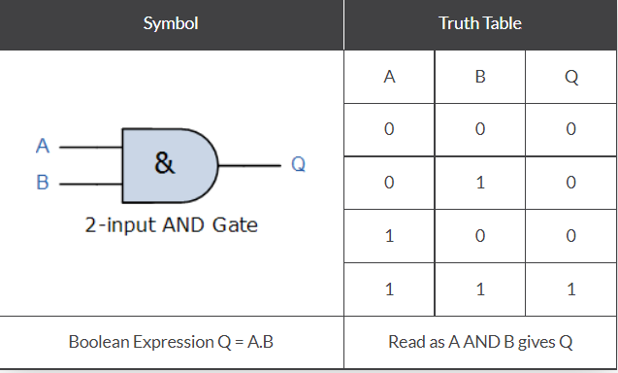
AND Gate
Two or more inputs
Output of an AND gate attains the state 1 if and only if all the inputs are in state 1

Slide 8
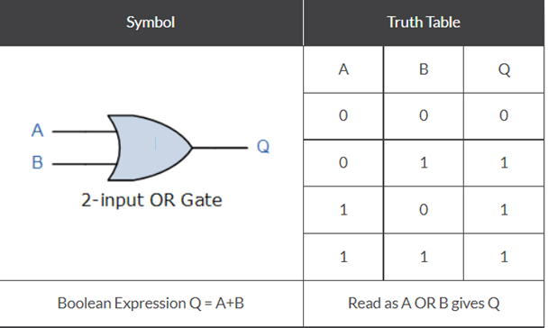
OR Gate
EITHER input A “OR” input B then Output also TRUE
Two or more inputs
In OR gate the output of an OR gate attains the state 1 if one or more inputs attain the state 1.

Slide 9
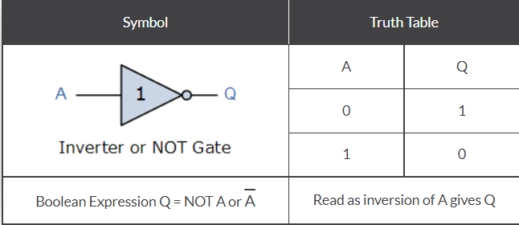
NOT Gate (Inverter)
One Input
One Output
Output of a NOT gate attains the state 1 if and only if the input does not attain the state 1.

Slide 10
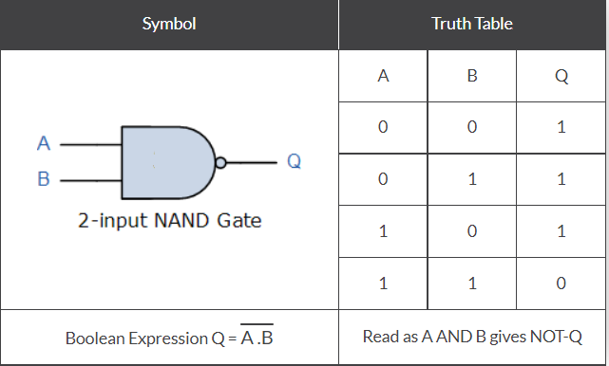
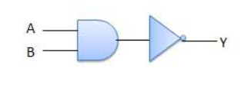
NAND Gate
Combination of AND and NOT
Two or more inputs
The output Q is NOT true if BOTH input A and input B are true.
Boolean Expression : ( Q = not(A AND B) )

Slide 11
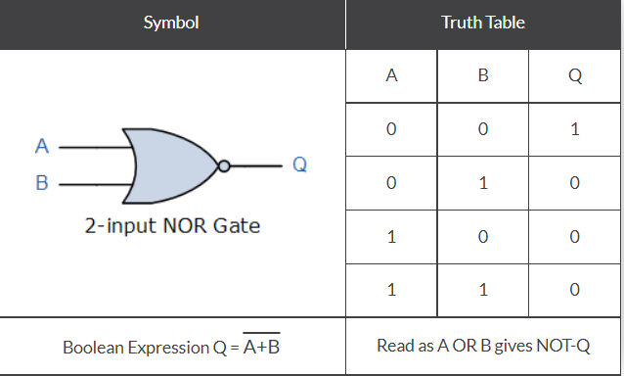
NOR Gate
Combination of OR and NOT
The output Q is true if BOTH input A and input B are NOT true.
Boolean Expression : ( Q = not(A OR B) )

Slide 12
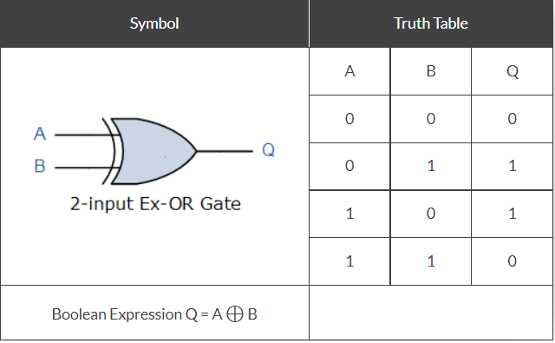
XOR Gate (Exclusive OR)
The output Q is true if EITHER input A or if input B is true, but NOT both
Produces output 1 for only those combinations that have odd number of 1’s
The XOR operation is defined by an encircled plus sign.
The Boolean expression is Q= (A⊕B) = A.B+A.B

Slide 13
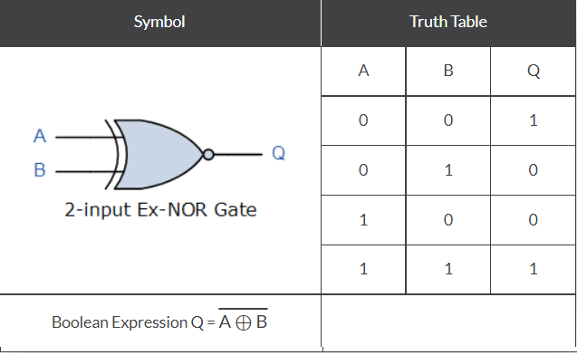
XNOR Gate (Exclusive NOR)
Exclusive-NOR gate or XNOR gate is formed by combining the Exclusive-OR gate (XOR gate) and the NOT gate
The output Q is true if BOTH input A and input B are the same, either true or false.
Boolean Expression : ( Q = (A and B) or (NOT A and NOT B) ).
Produces output 1 for only those combinations that have even number of 1’s

Slide 14
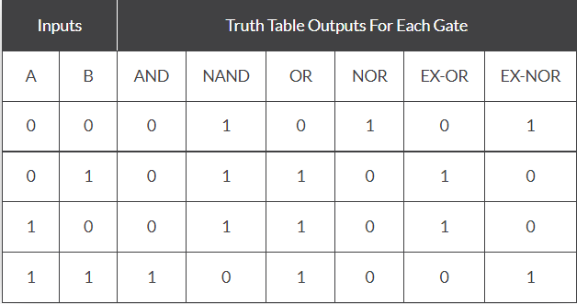
Summary of 2-input Logic Gates

Slide 15
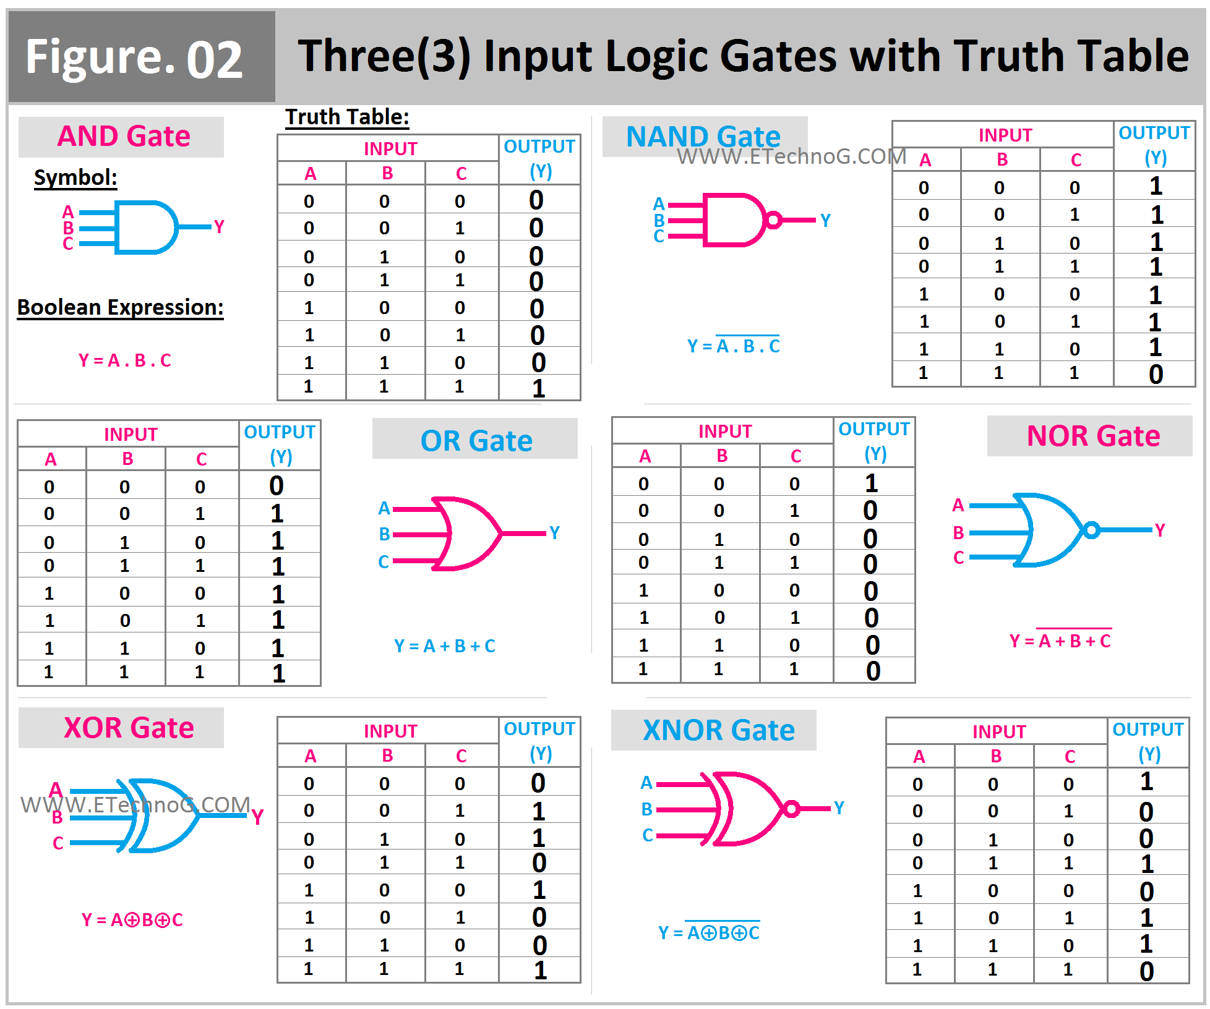

Slide 16
Basic Postulates of Boolean Algebra
If X ≠ 0 then X = 1
If X ≠ 1 then X = 0
Logical Addition ➔ OR [ 0 + 0 = 0, 0+1=1, 1 + 0 = 1, 1 + 1 =1 ]
Logical Multiplication → AND [ 0 . 0 = 0, 0.1=0, 1 . 0 = 0, 1 . 1 =1 ]
Complement Rule : 0’ = 1, 1’ = 0

Slide 17
Laws of Boolean Algebra
There are six types of Boolean algebra laws. They are:
Commutative law
Associative law
Distributive law
AND law
OR law
Inversion law

Slide 18
Commutative Law
Any binary operation which satisfies the following expression is referred to as a commutative operation.
Commutative law states that changing the sequence of the variables does not have any effect on the output of a logic circuit.
A. B = B. A
A + B = B + A

Slide 19
Associative Law
It states that the order in which the logic operations are performed is irrelevant as their effect is the same.
( A. B ). C = A . ( B . C )
( A + B ) + C = A + ( B + C)

Slide 20
Distributive Law
Distributive law states the following conditions:
A. ( B + C) = (A. B) + (A. C)
A + (B. C) = (A + B) . ( A + C)

Slide 21
AND Law
These laws use the AND operation. Therefore they are called AND laws.
A .0 = 0
A . 1 = A
A. A = A
A.A'=0

Slide 22
OR Law
These laws use the OR operation. Therefore they are called OR laws.
A + 0 = A
A + 1 = 1
A + A = A
A + A'=1

Slide 23
Inversion Law
In Boolean algebra, the inversion law states that double inversion of variable results in the original variable itself.
A’’=A

Slide 24
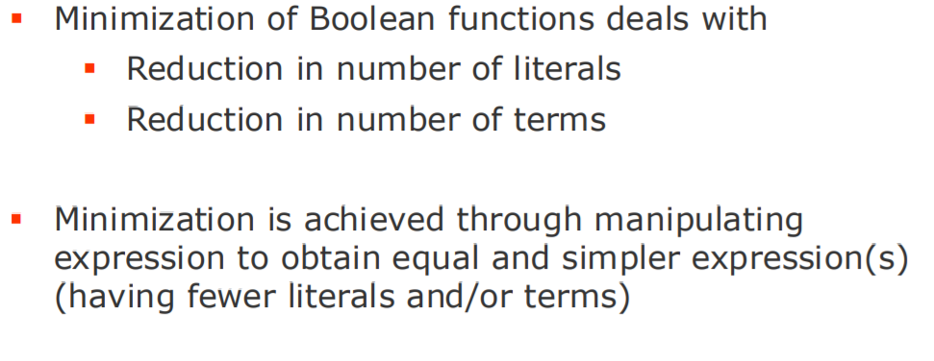
Simplification of Boolean Functions
A simplified Boolean expression uses the fewest gates possible to implement a given expression.
A Boolean expression can be implemented using Logic Gates (Digital Circuits)
Smaller the expression faster it is

Slide 25
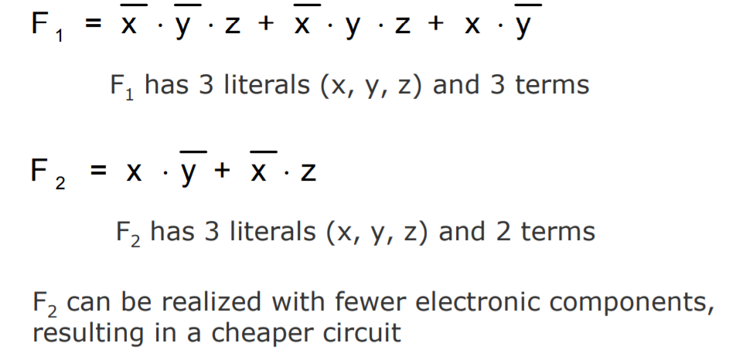
Simplification of Boolean Functions

Slide 26
simplification
A+(A’.B)
A.(A’+B)
(A+A’).(A+B) DISTRIBUTIVE LAW
1.(A+B) -----A+A’=1
A+B-----(1.A=A)
A+B
A.A’+A.B -----DISTRIBUTIVE LAW
0+(A.B)------A.A’=0
(A.B)------(0+A=A)
A,B

Slide 27
Boolean Algebra Theorems
The two important theorems which are extremely used in Boolean algebra are De Morgan’s First law and De Morgan’s second law.
These two theorems are used to change the Boolean expression.
This theorem basically helps to reduce the given Boolean expression in the simplified form.
These two De Morgan’s laws are used to change the expression from one form to another form.

Slide 28
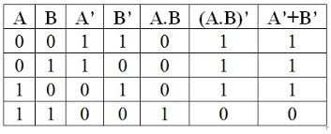
De Morgan’s First Law:
De Morgan’s First Law states that (A.B)’ = A’+B’.
The first law states that the complement of the product of the variables is equal to the sum of their individual complements of a variable.
A.B= A + B

Slide 29
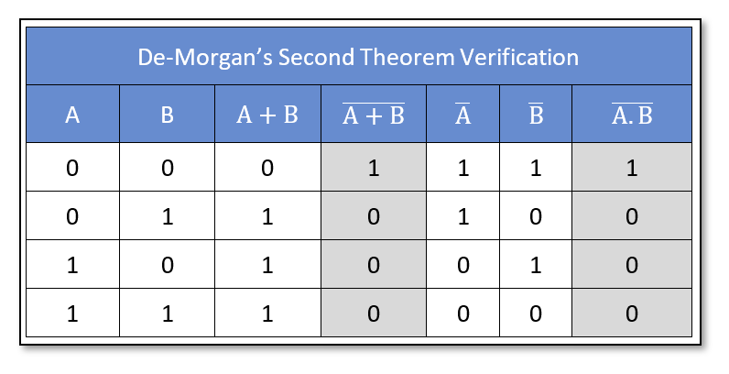
De Morgan’s Second Law:
De Morgan’s Second law states that (A+B)’ = A’. B’.
The second law states that the complement of the sum of variables is equal to the product of their individual complements of a variable.
A+B A . B

Slide 30
According to De Morgan's theorem,
A NAND gate is equivalent to an OR gate with inverted inputs. Similarly, a NOR gate is equivalent to an AND gate with inverted inputs.

Slide 31
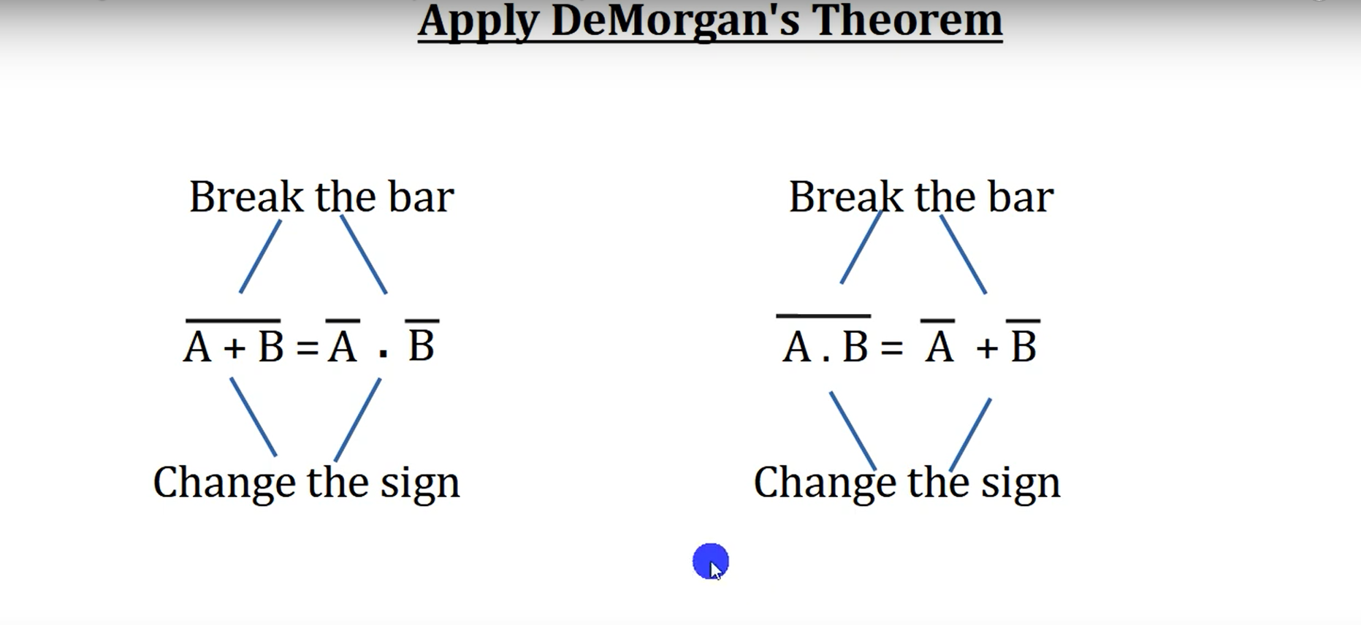

Slide 32


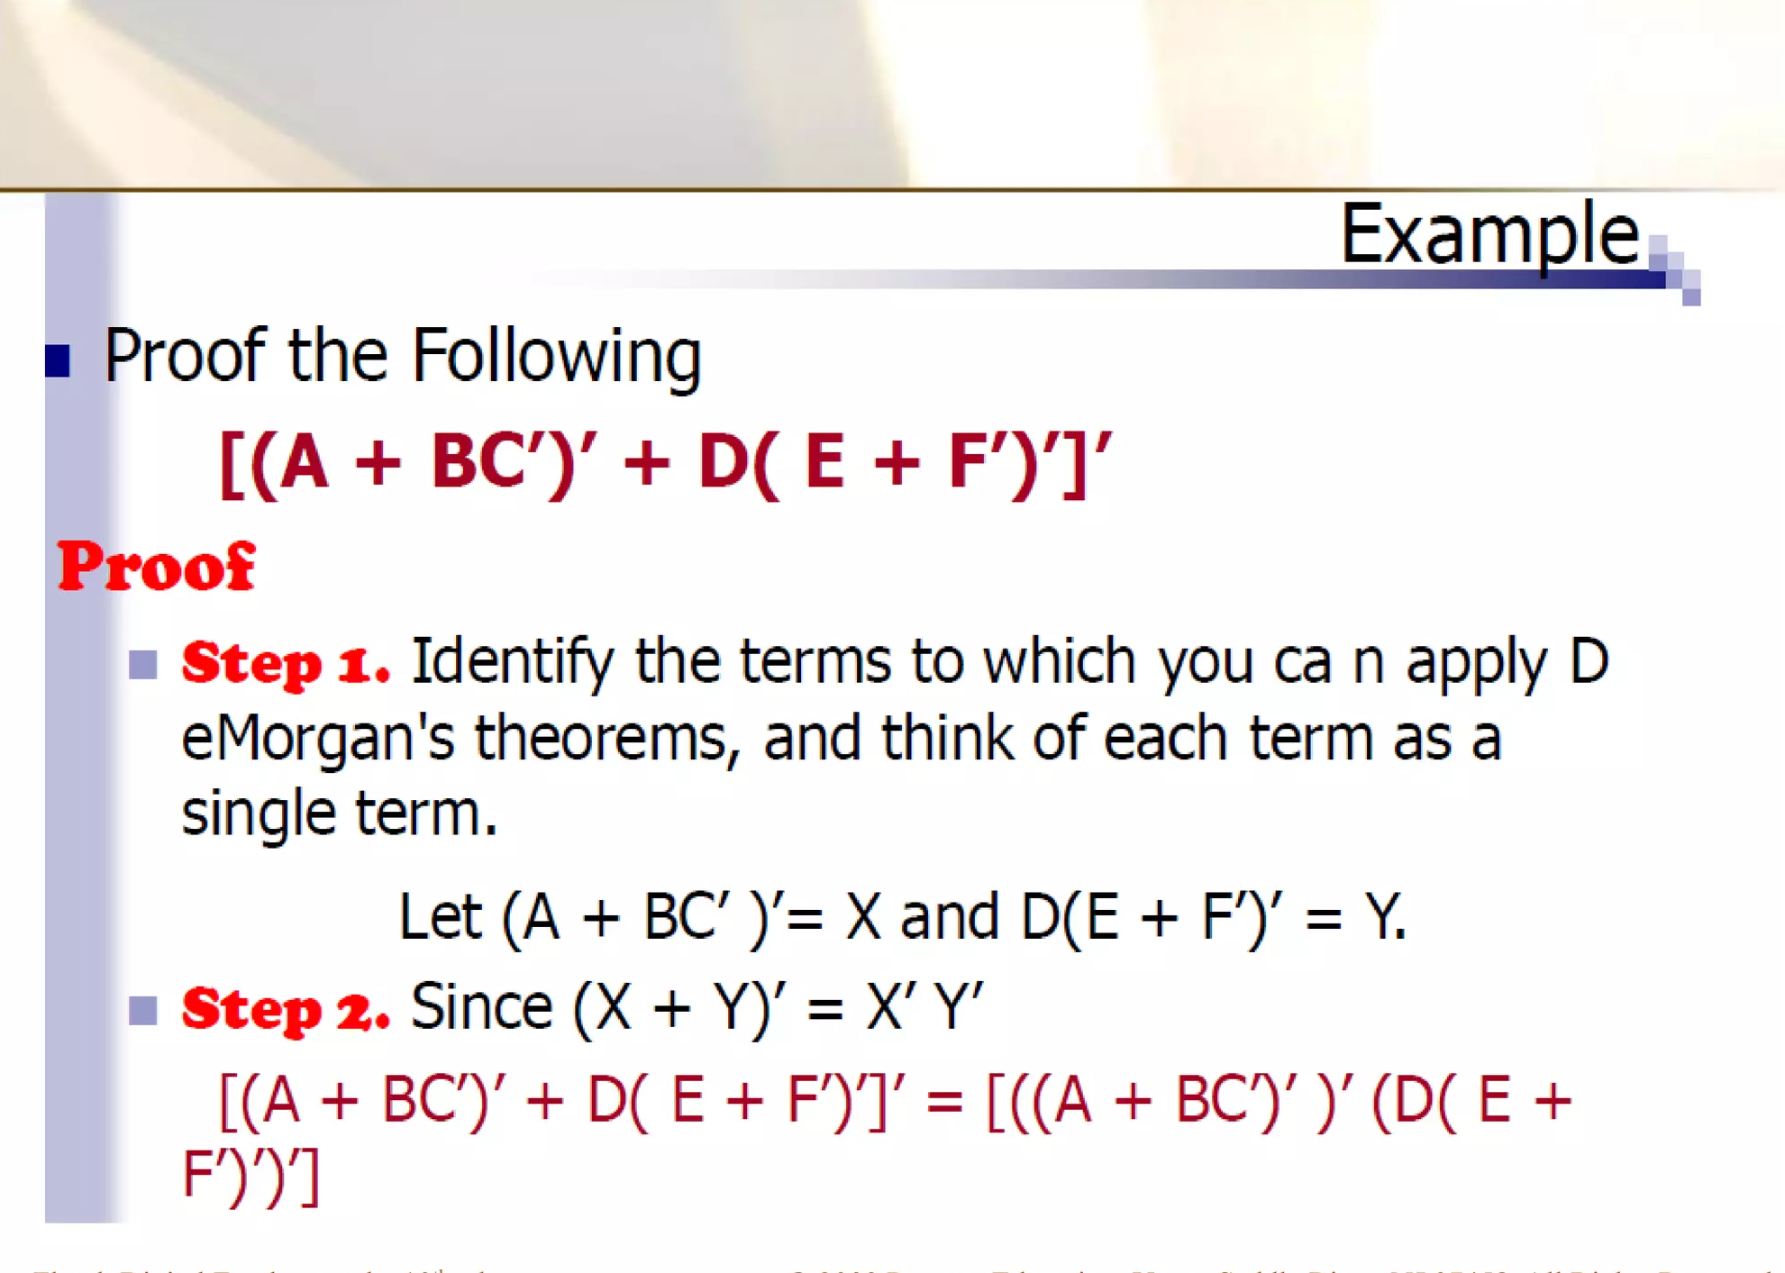




Slide 33
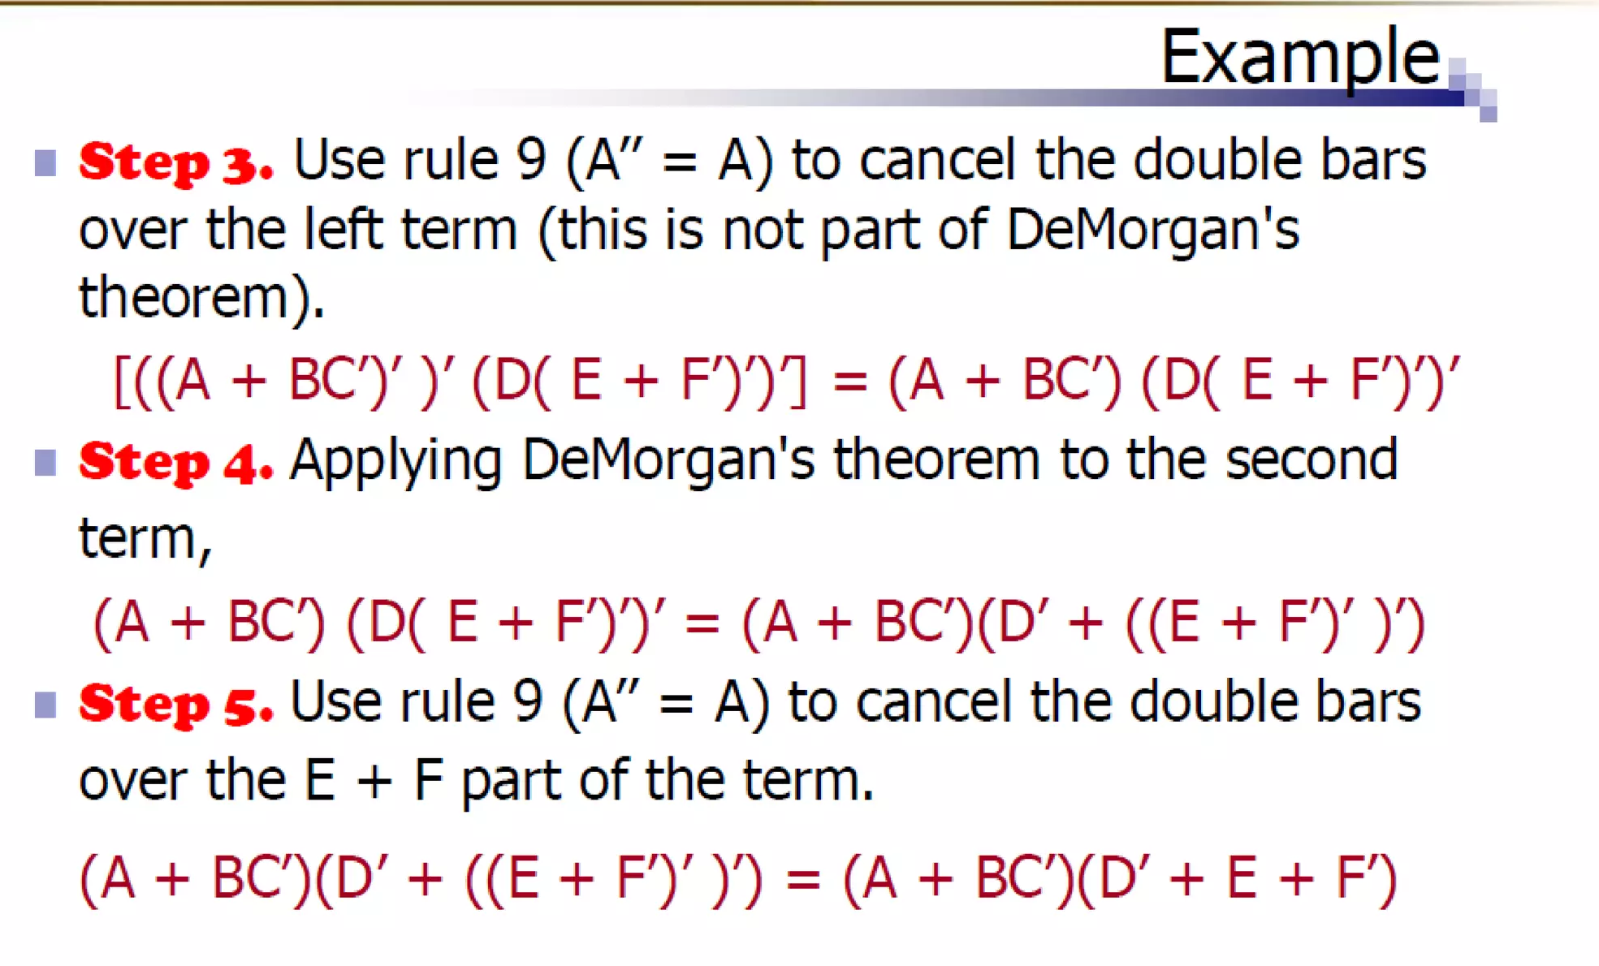

Slide 34
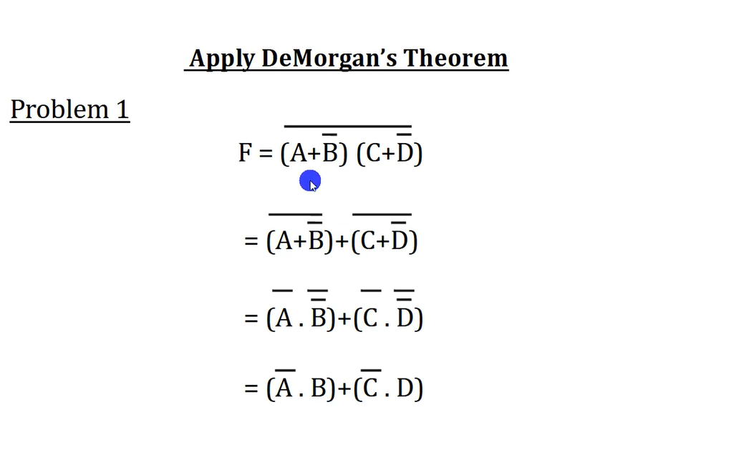

Slide 35
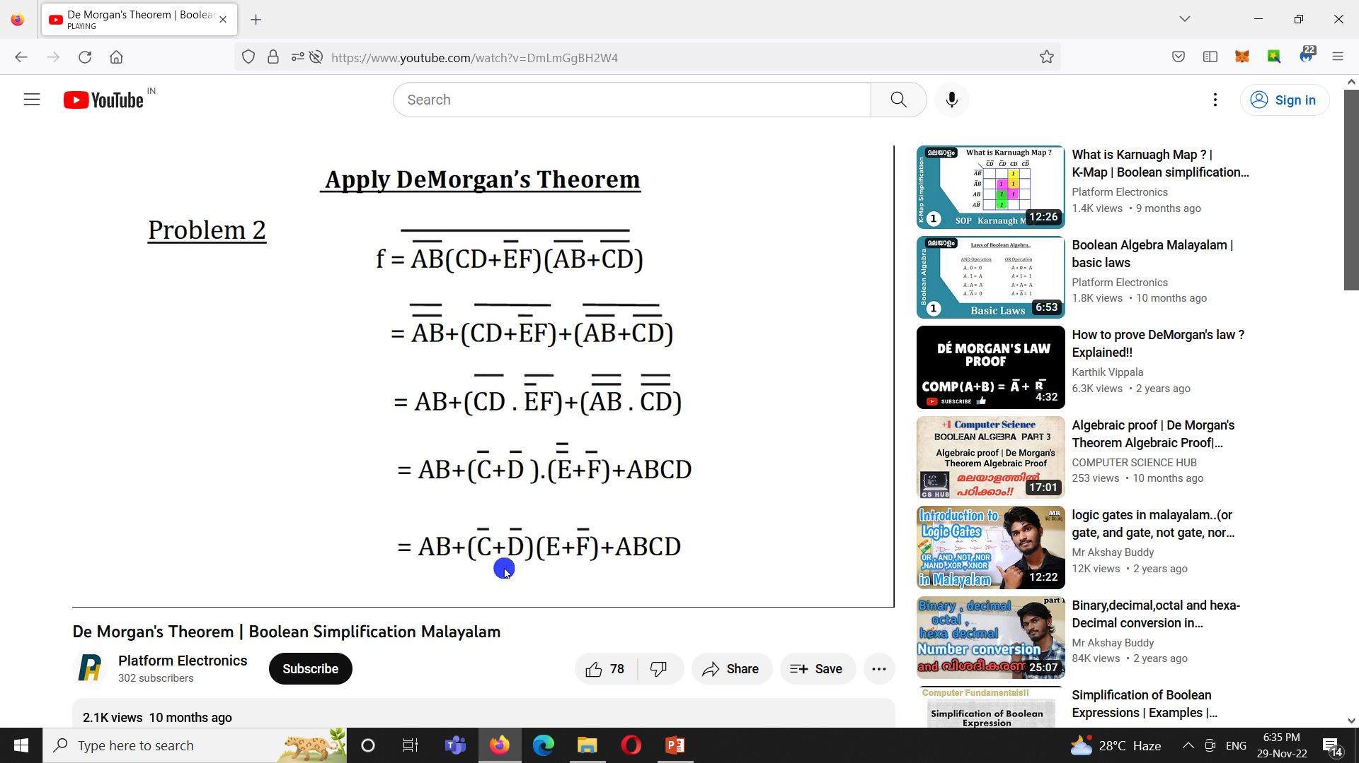

Slide 37
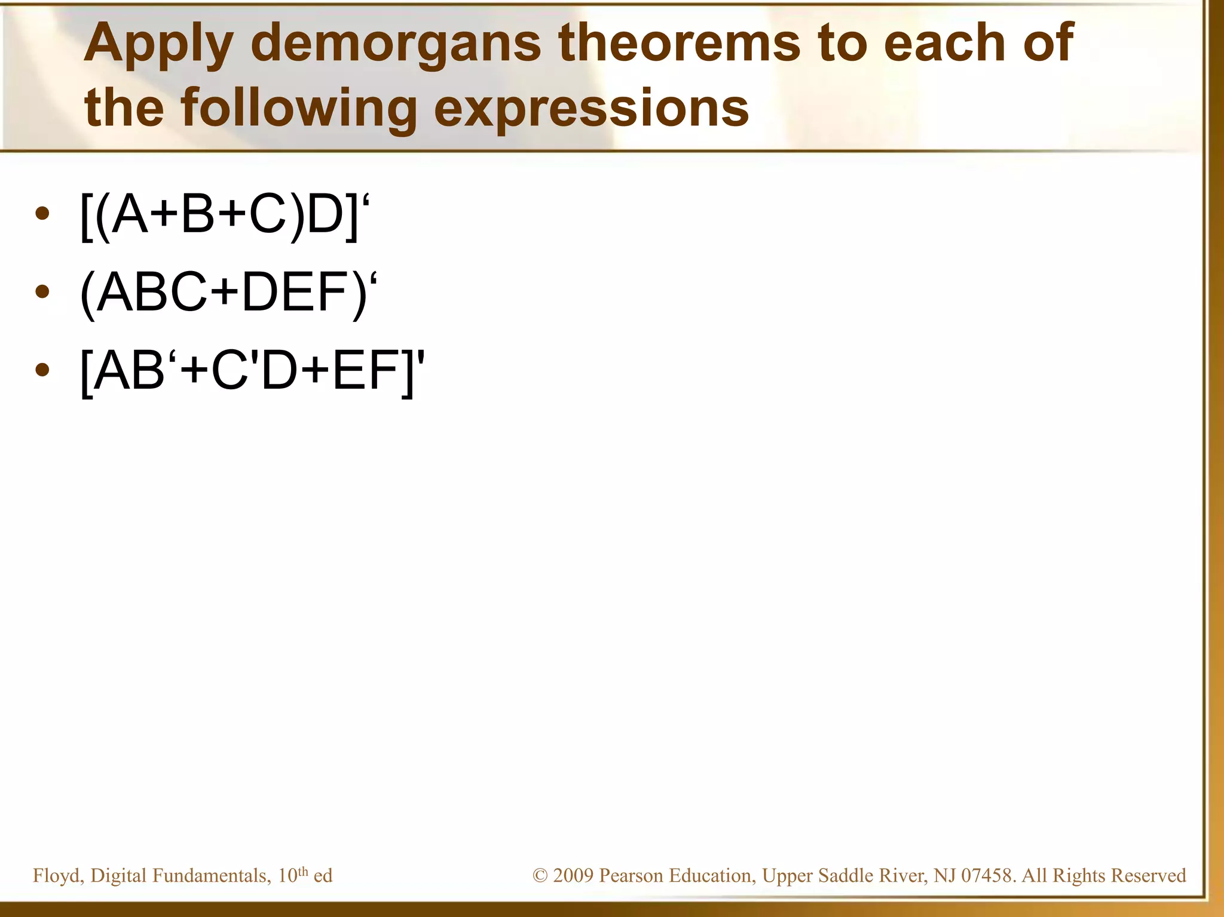

Slide 38
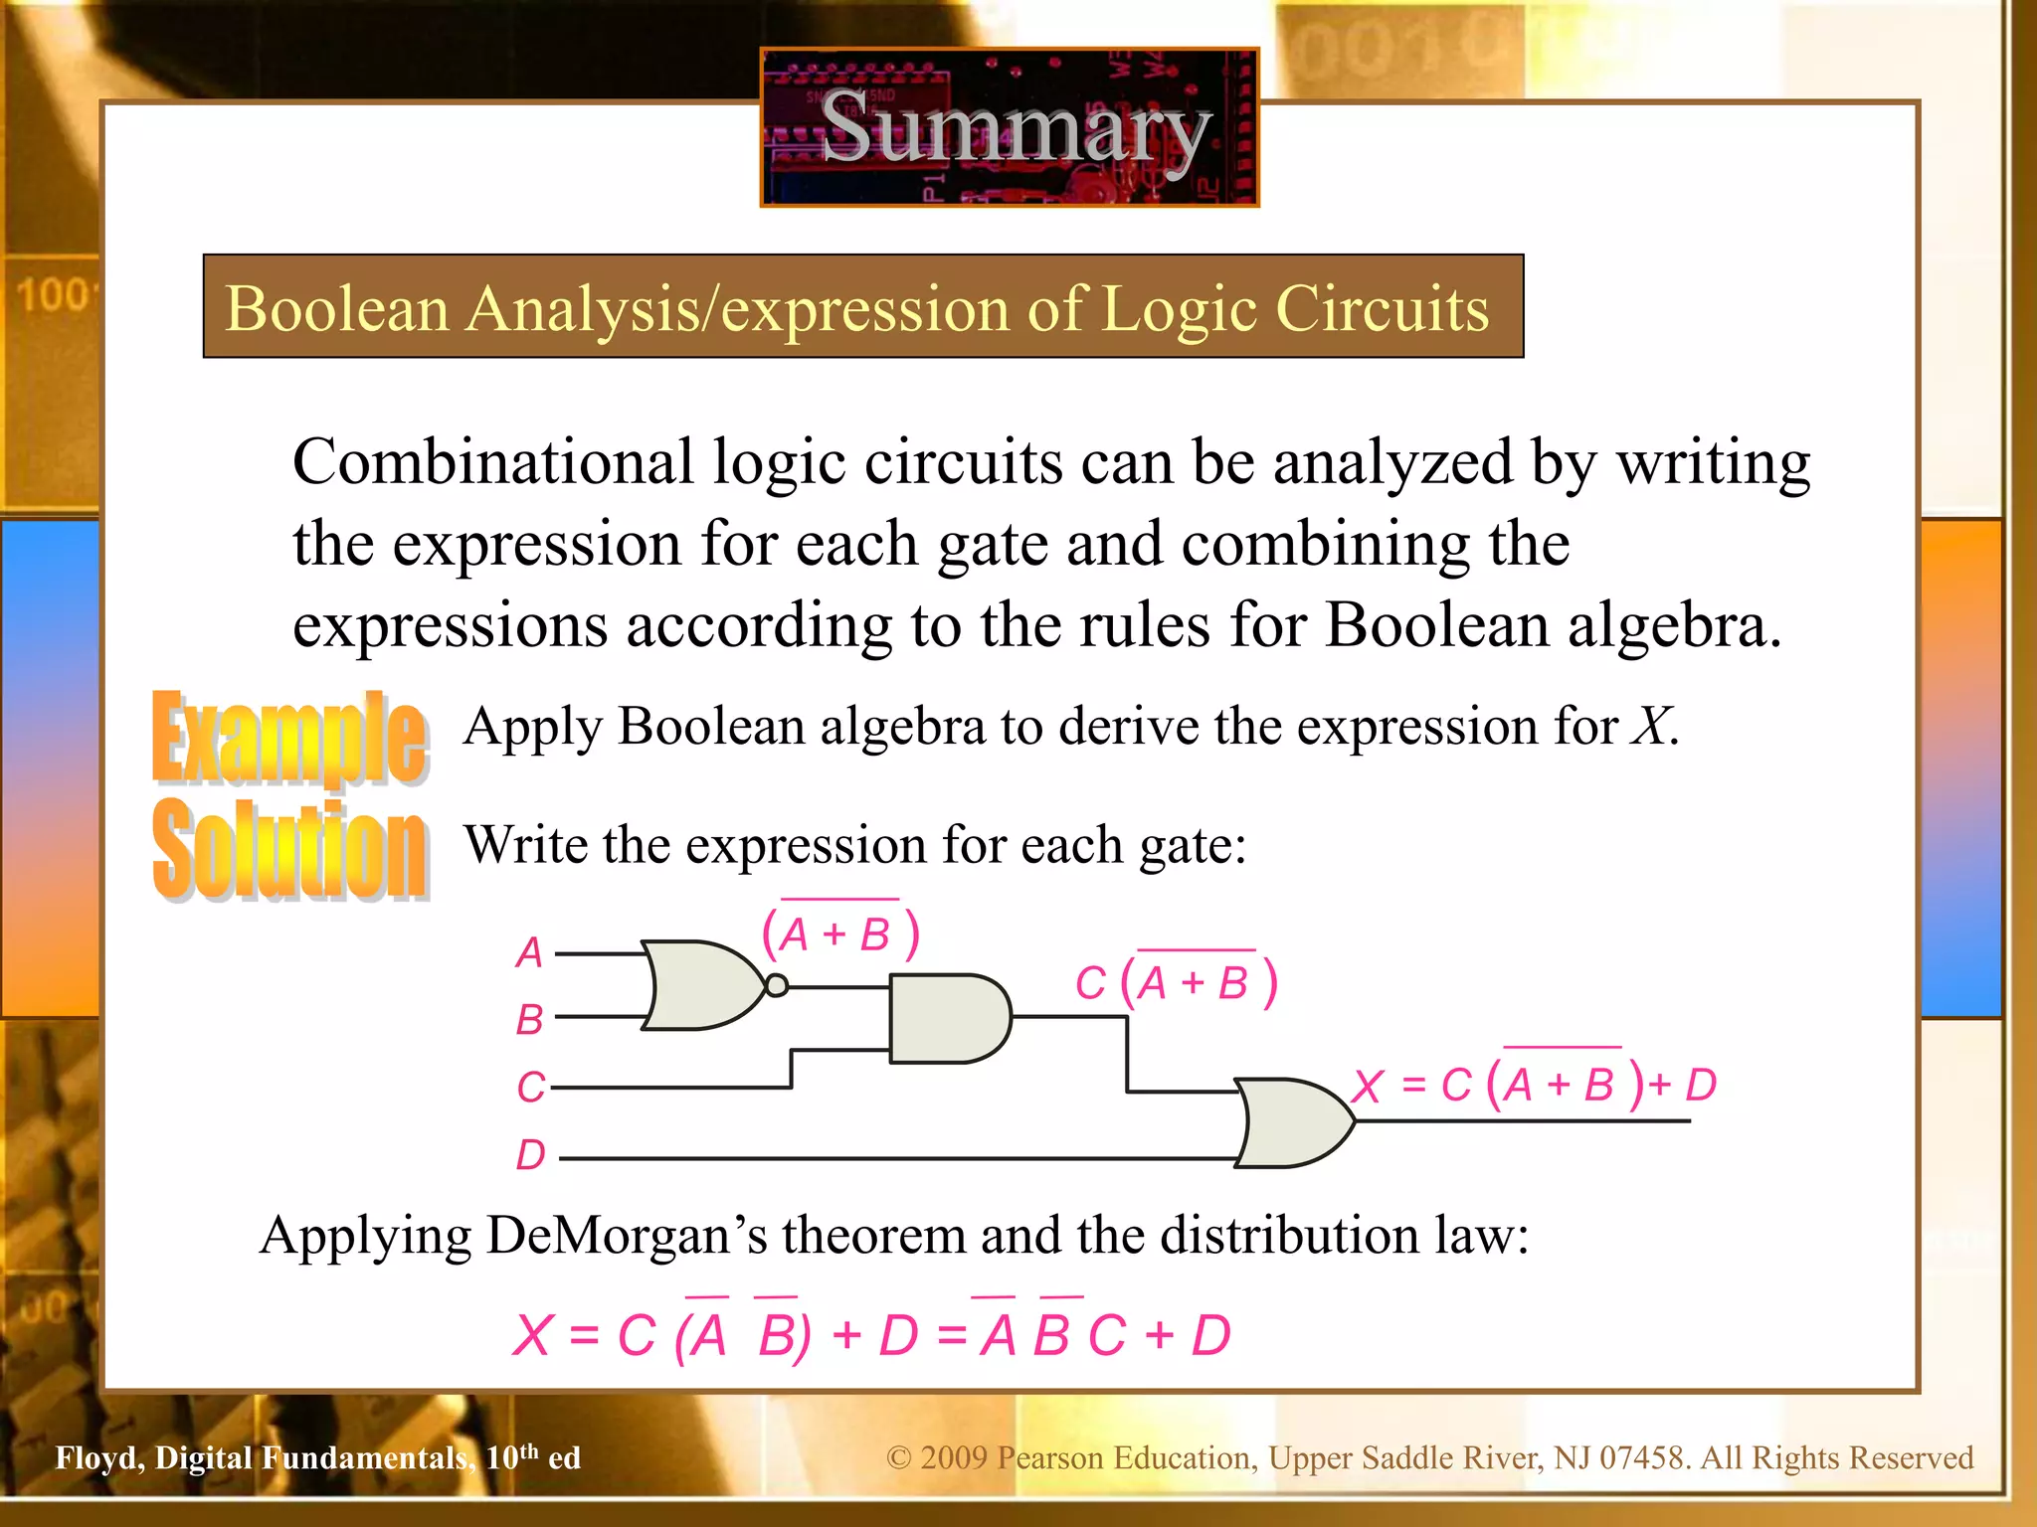

Slide 39
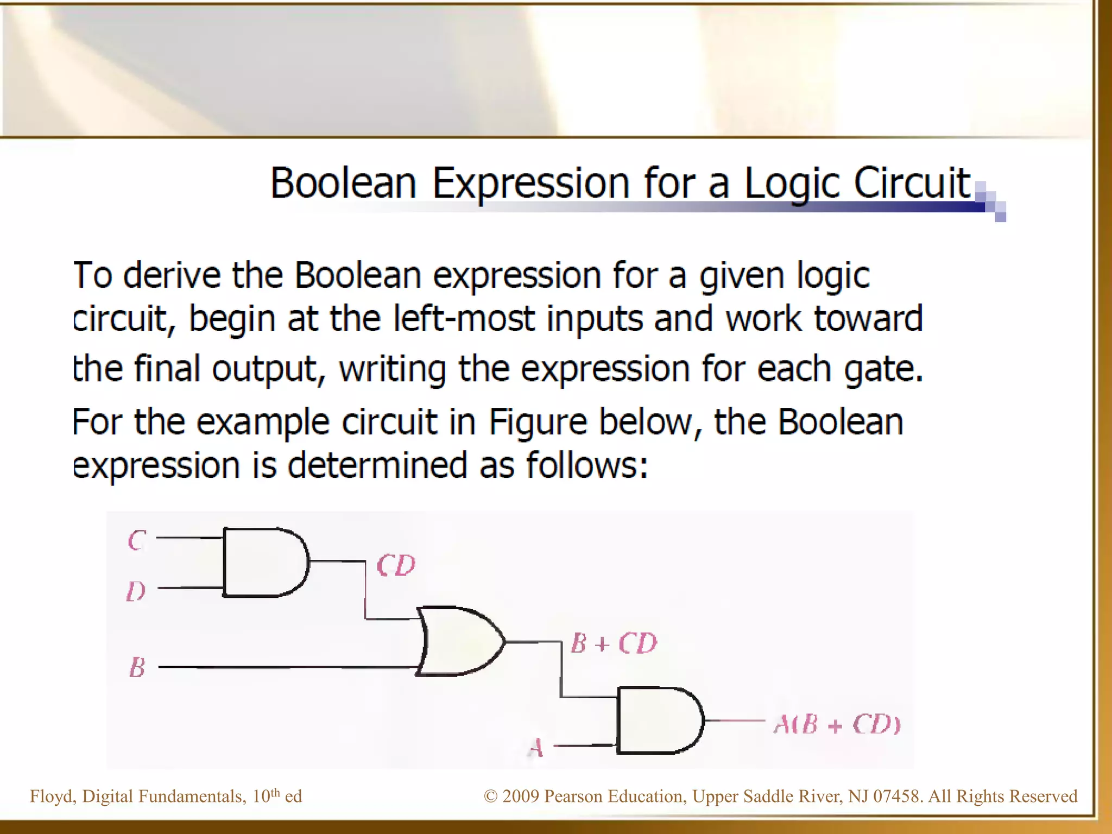

Slide 40
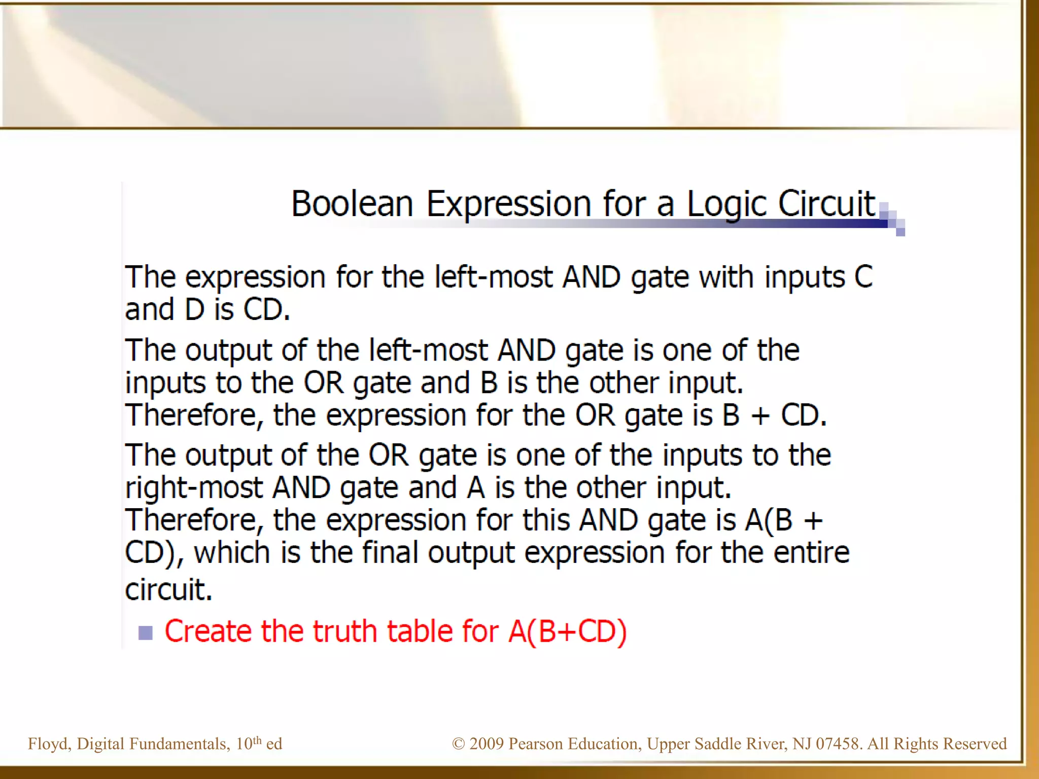

Slide 41
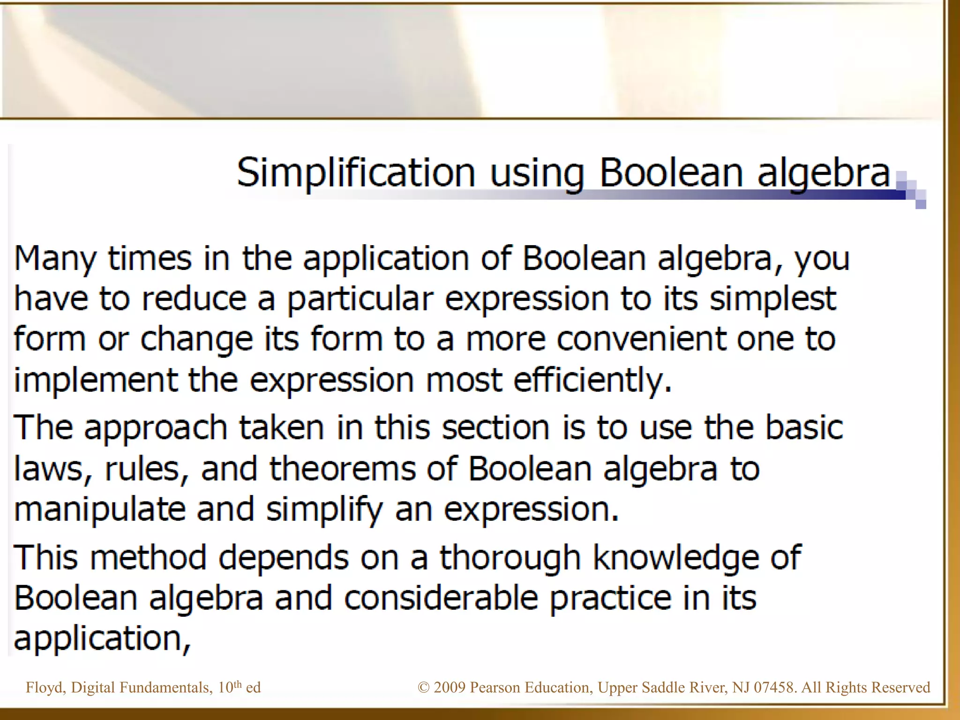

Slide 42
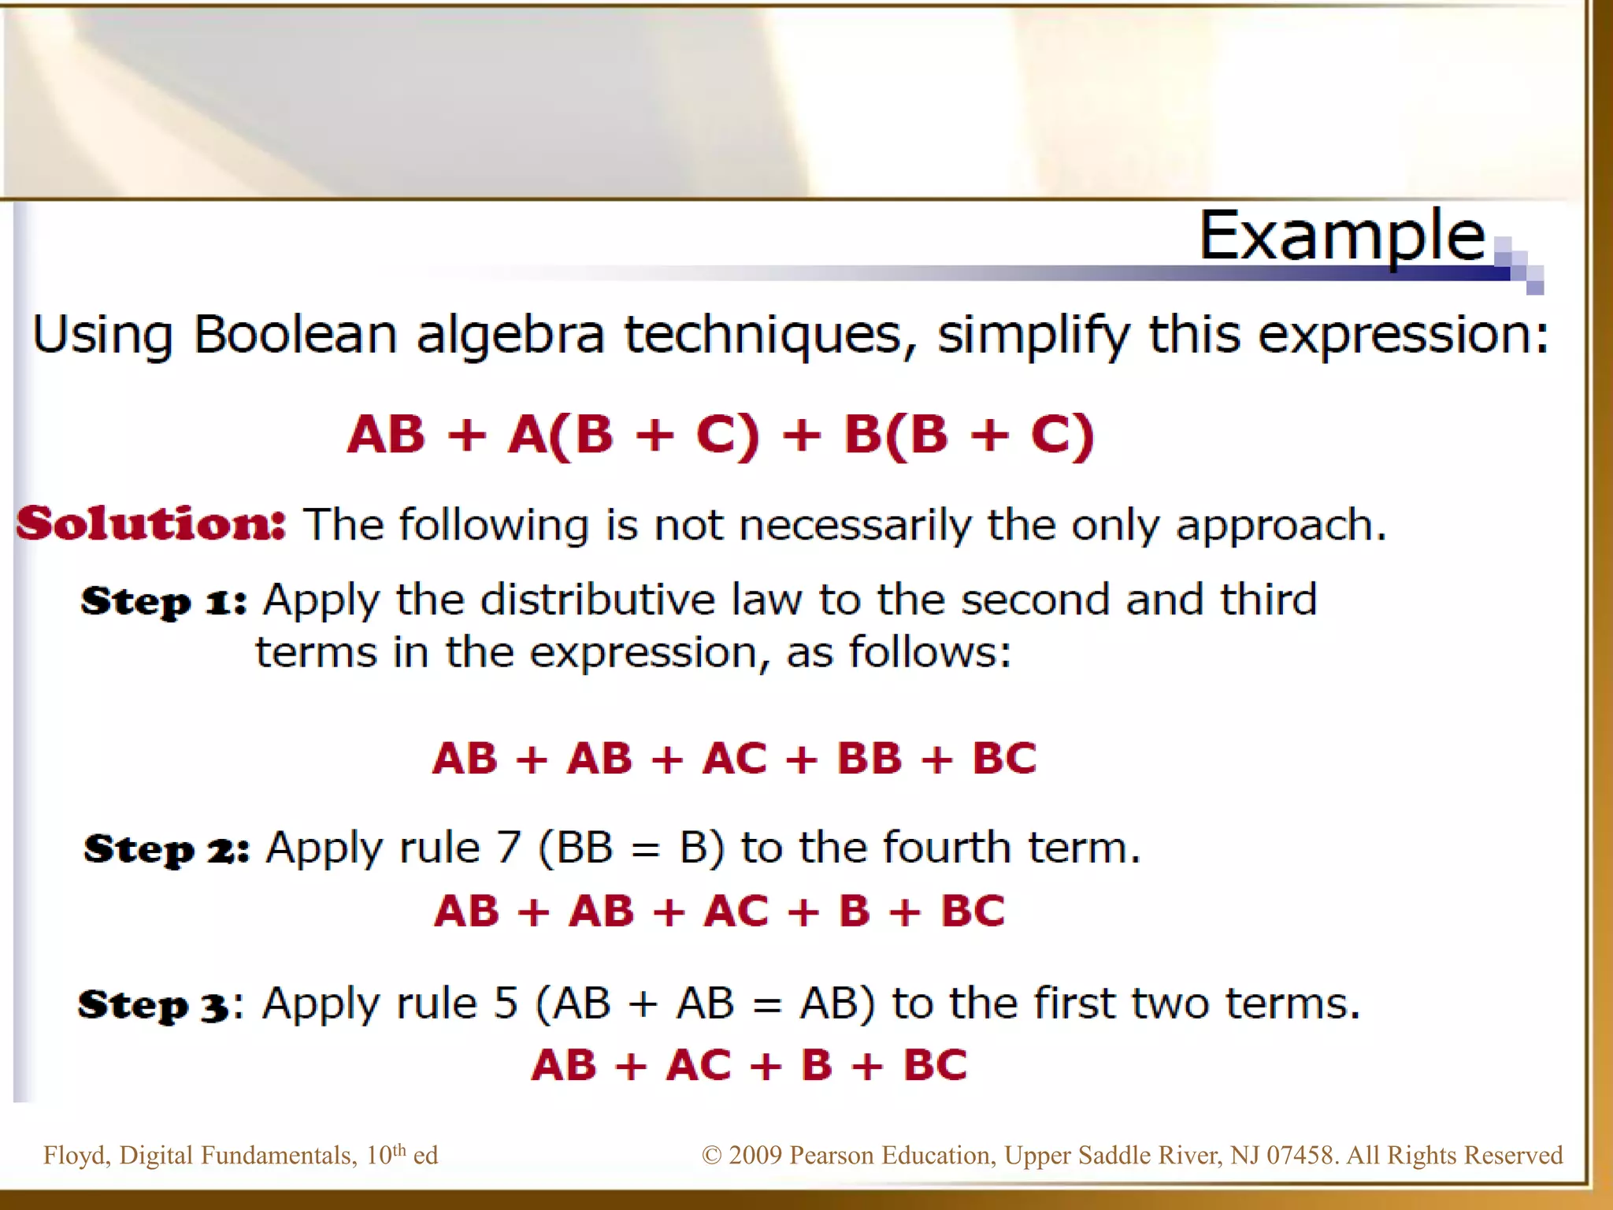

Slide 43
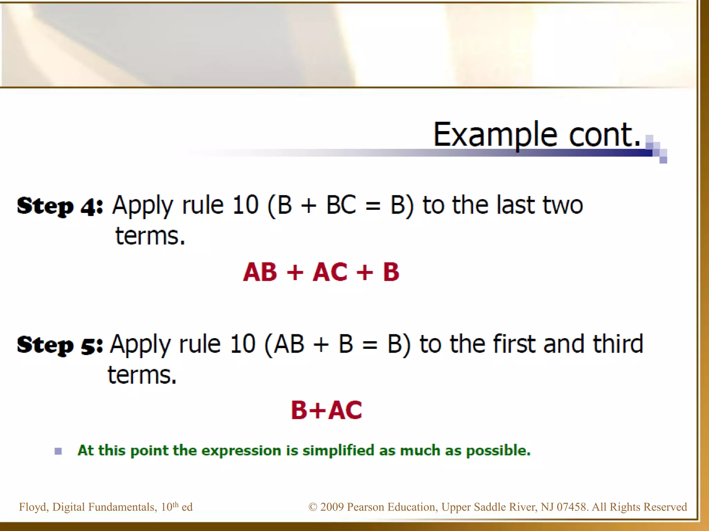

Slide 44
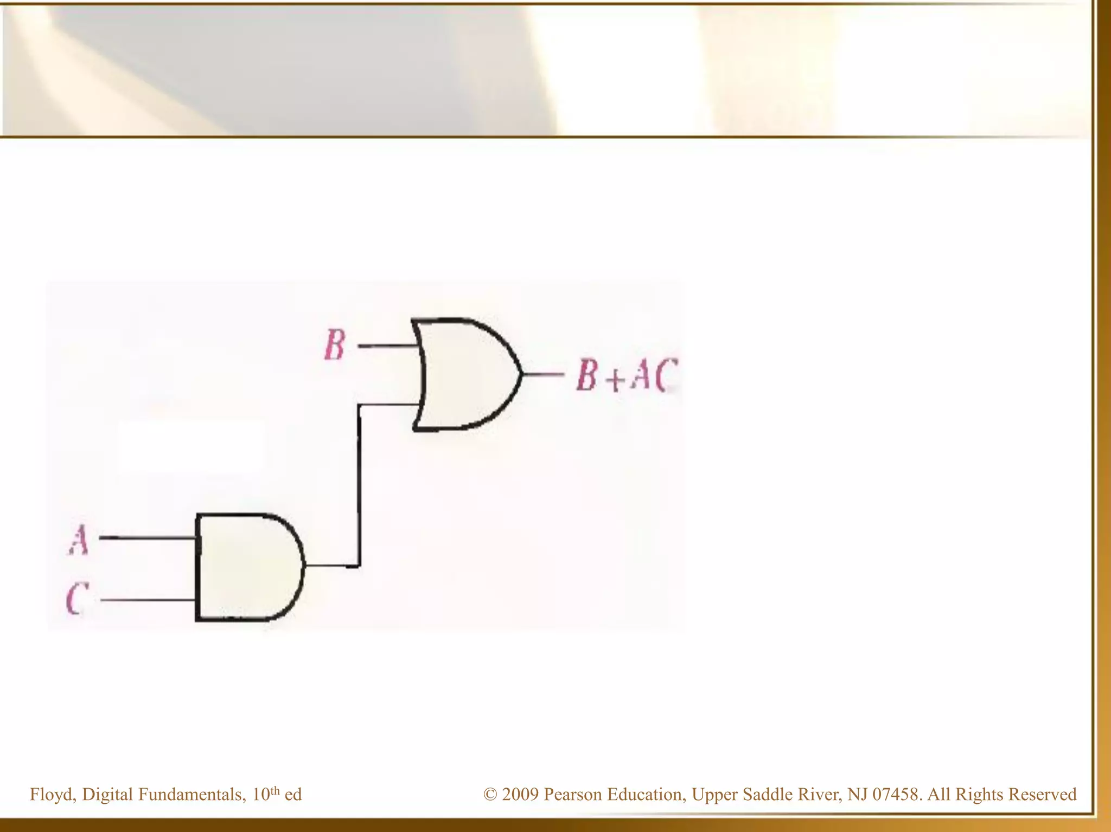

Slide 45
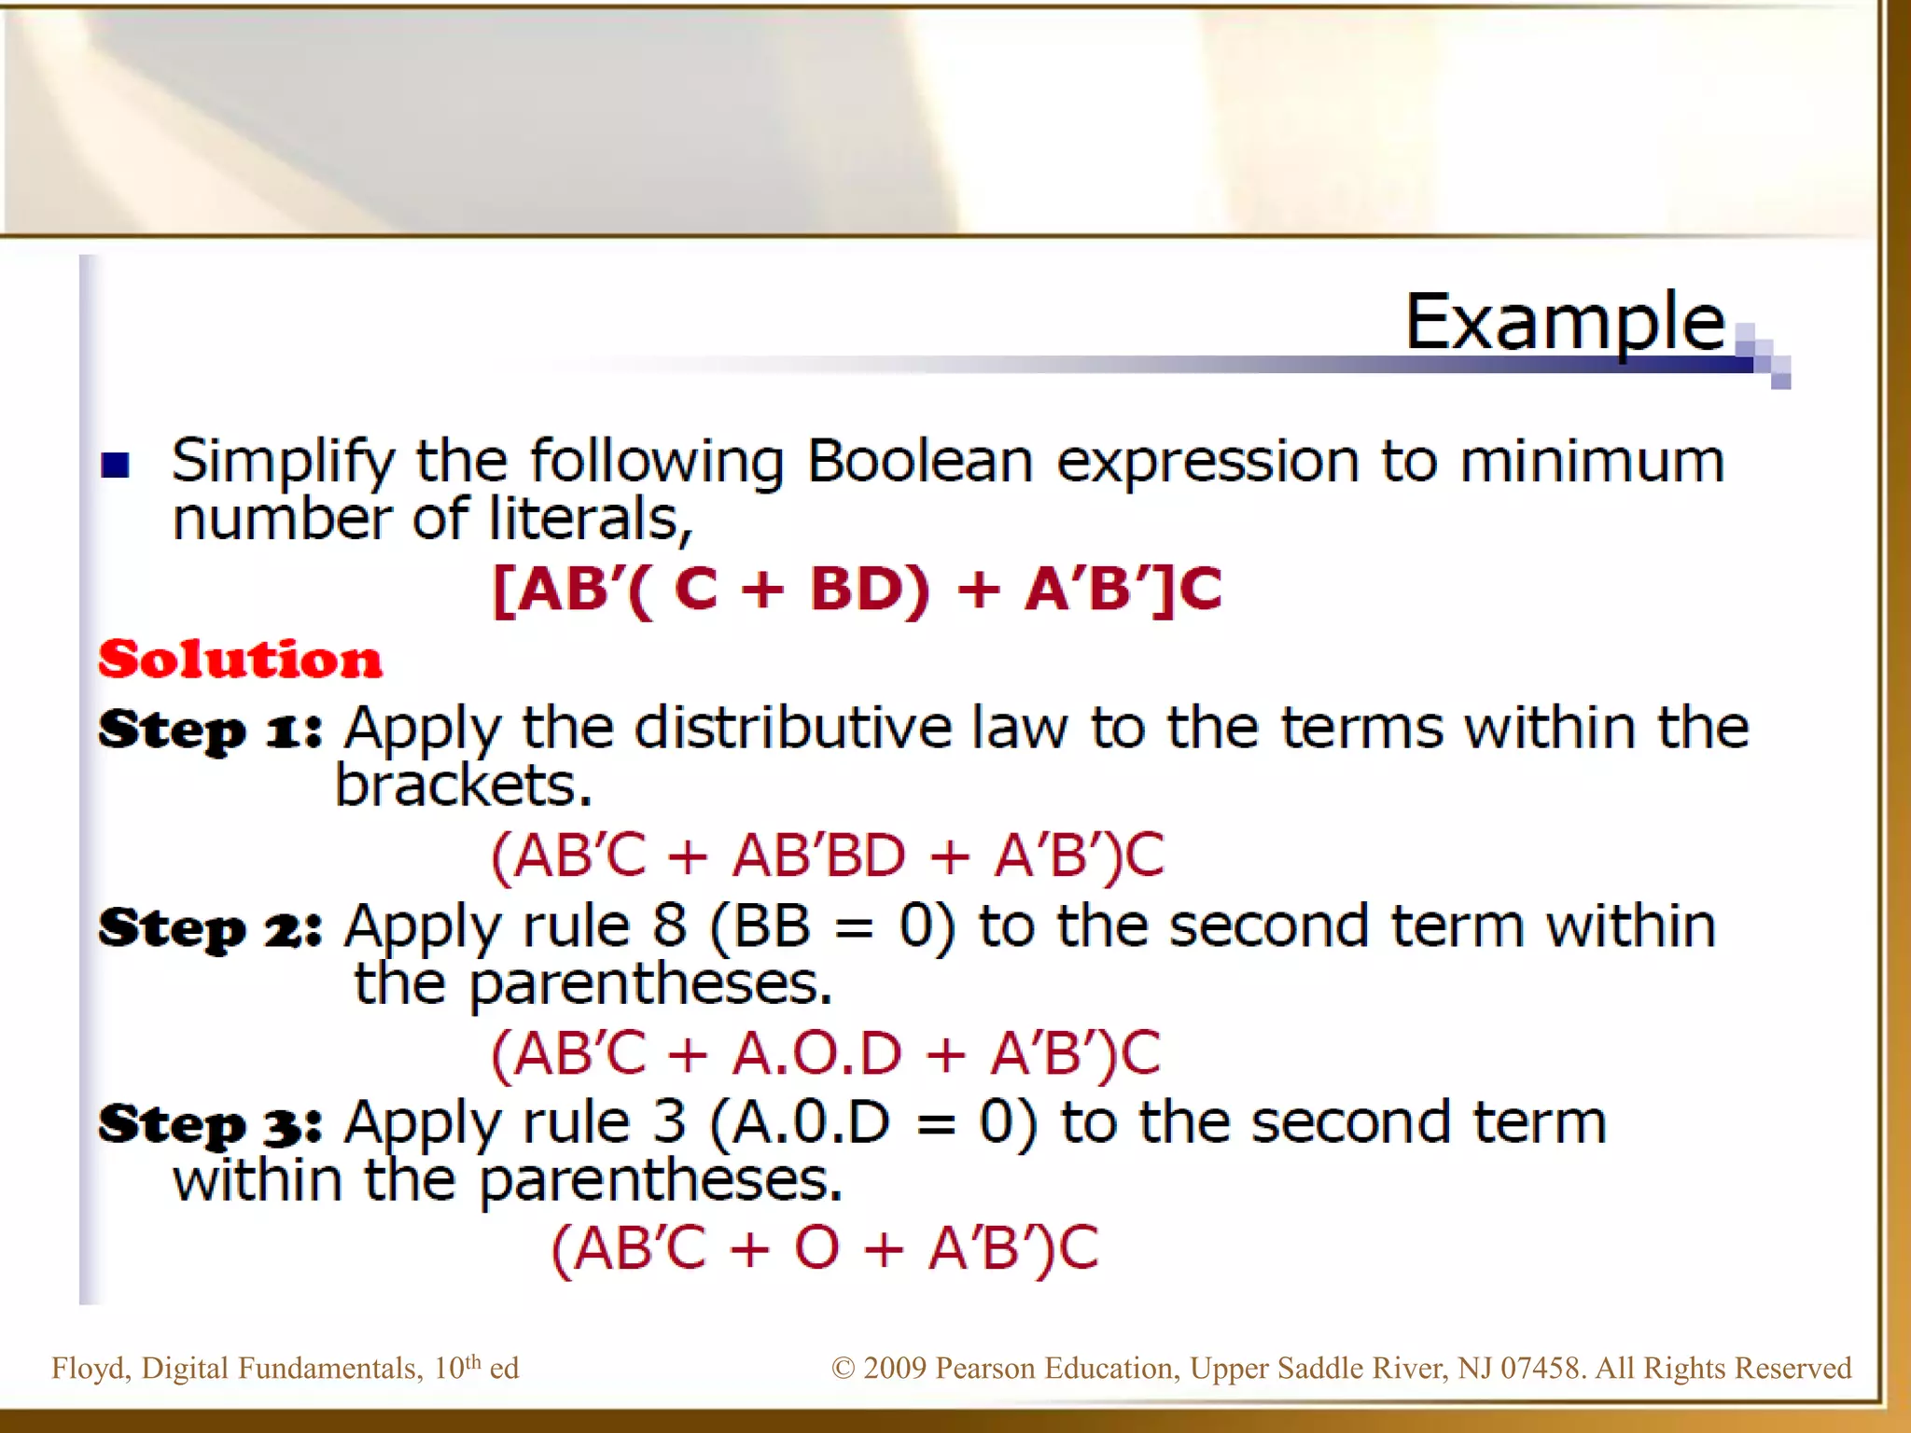

Slide 46
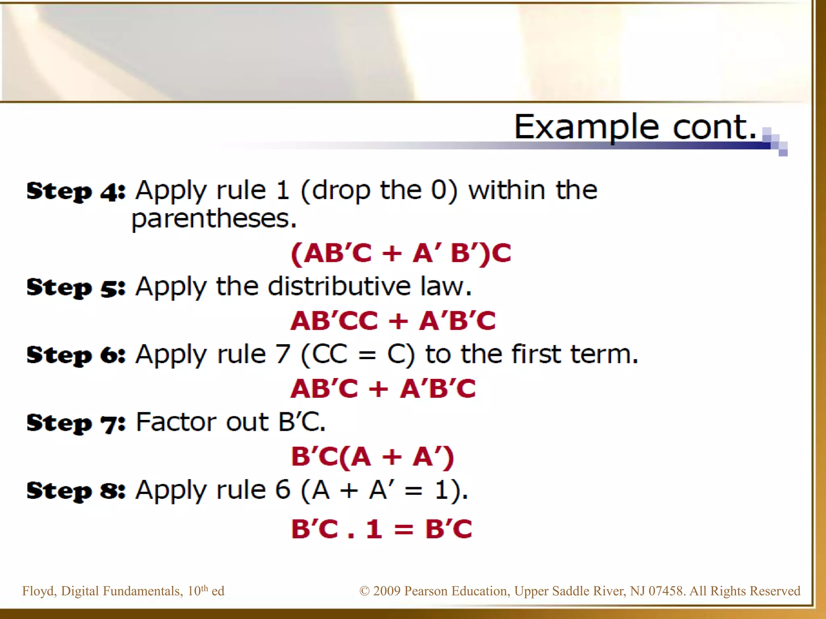

Slide 47
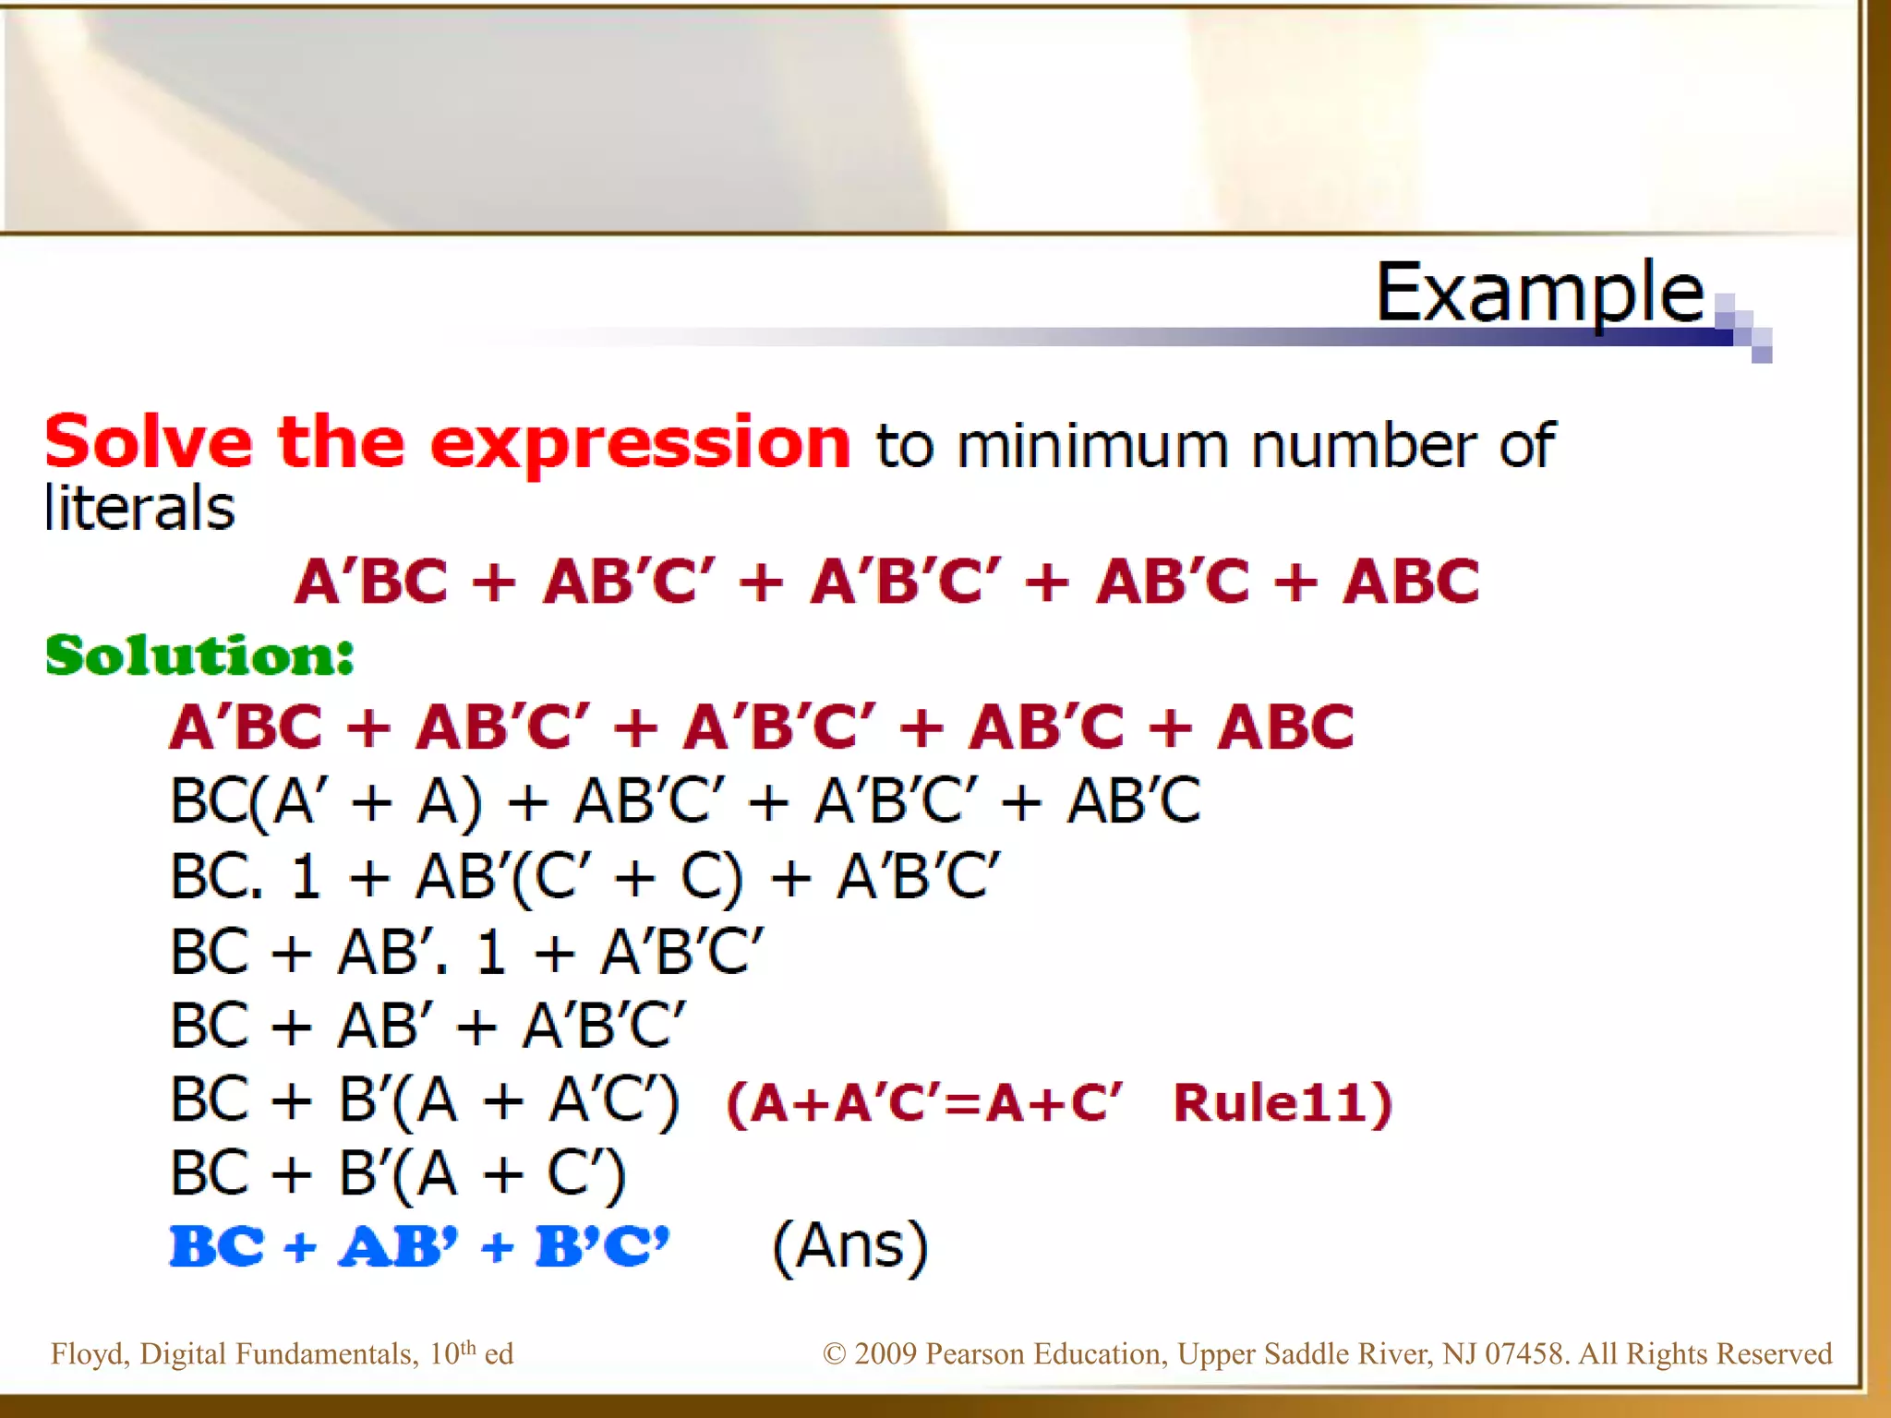

Slide 48
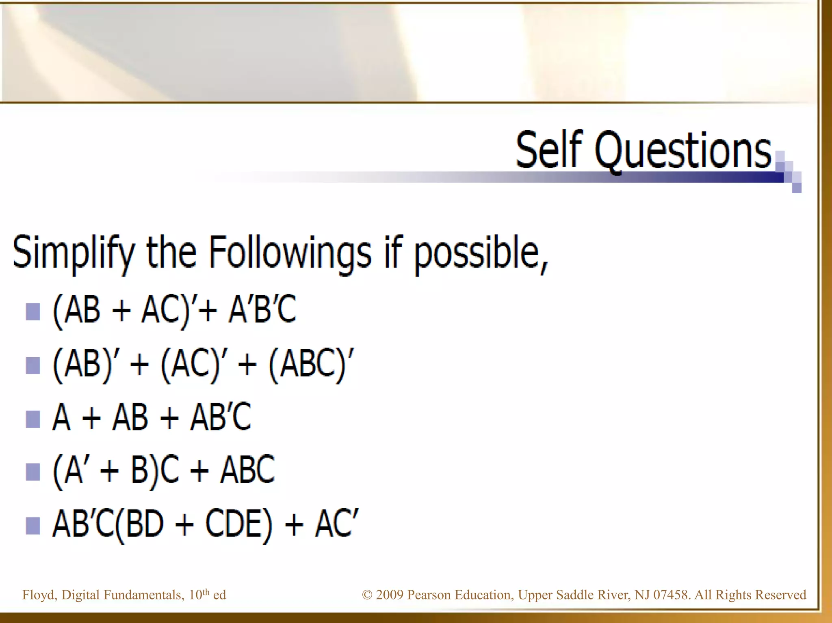

Slide 49
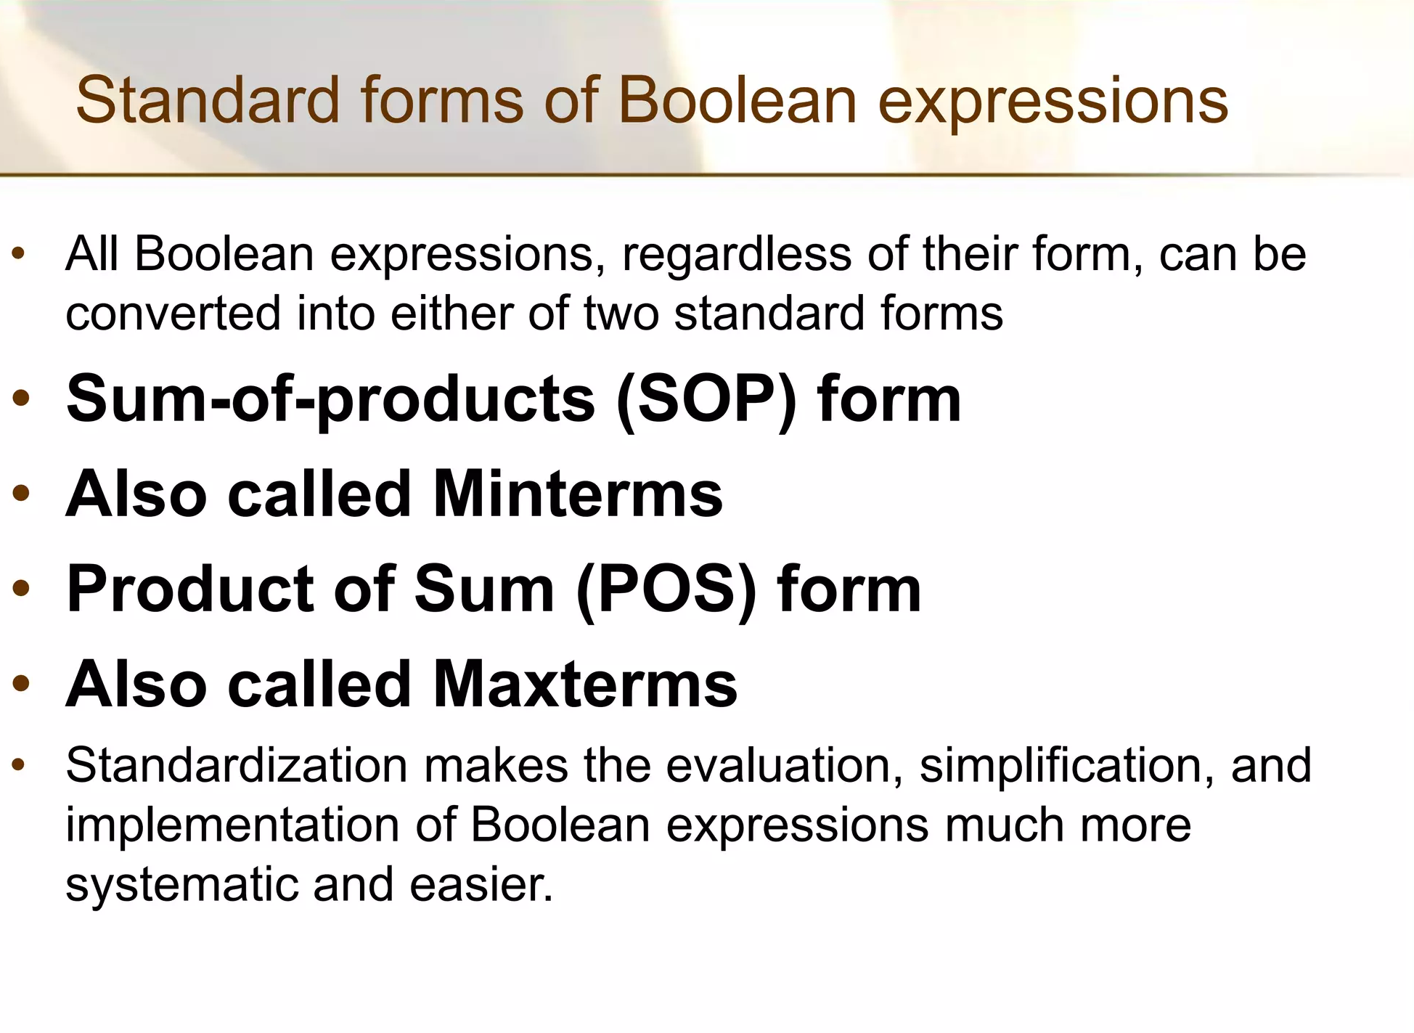

Slide 50
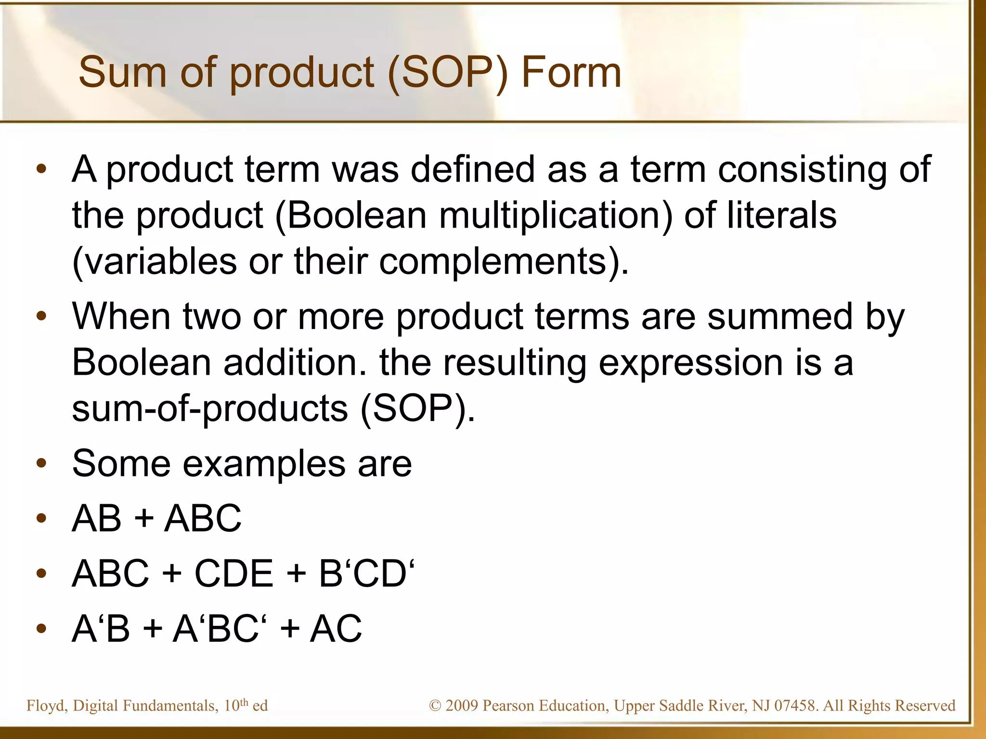

Slide 51
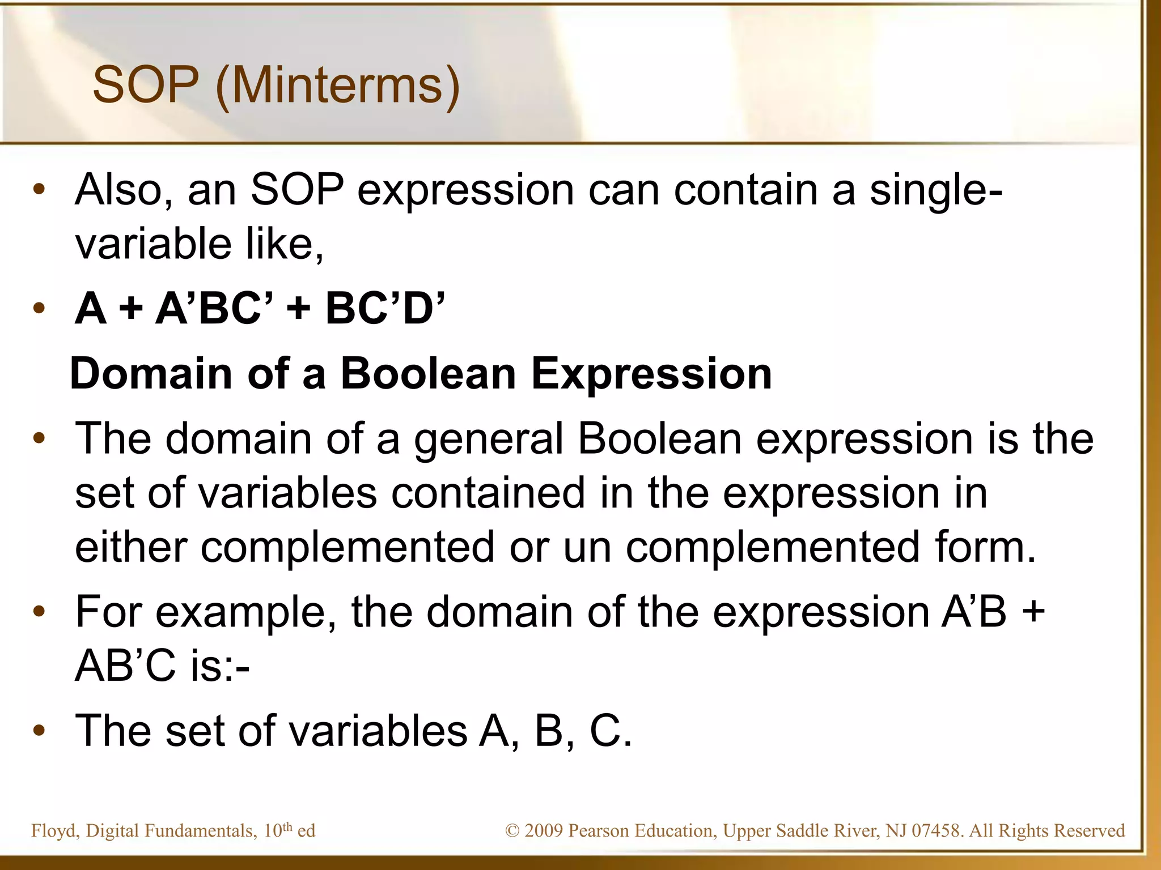

Slide 52
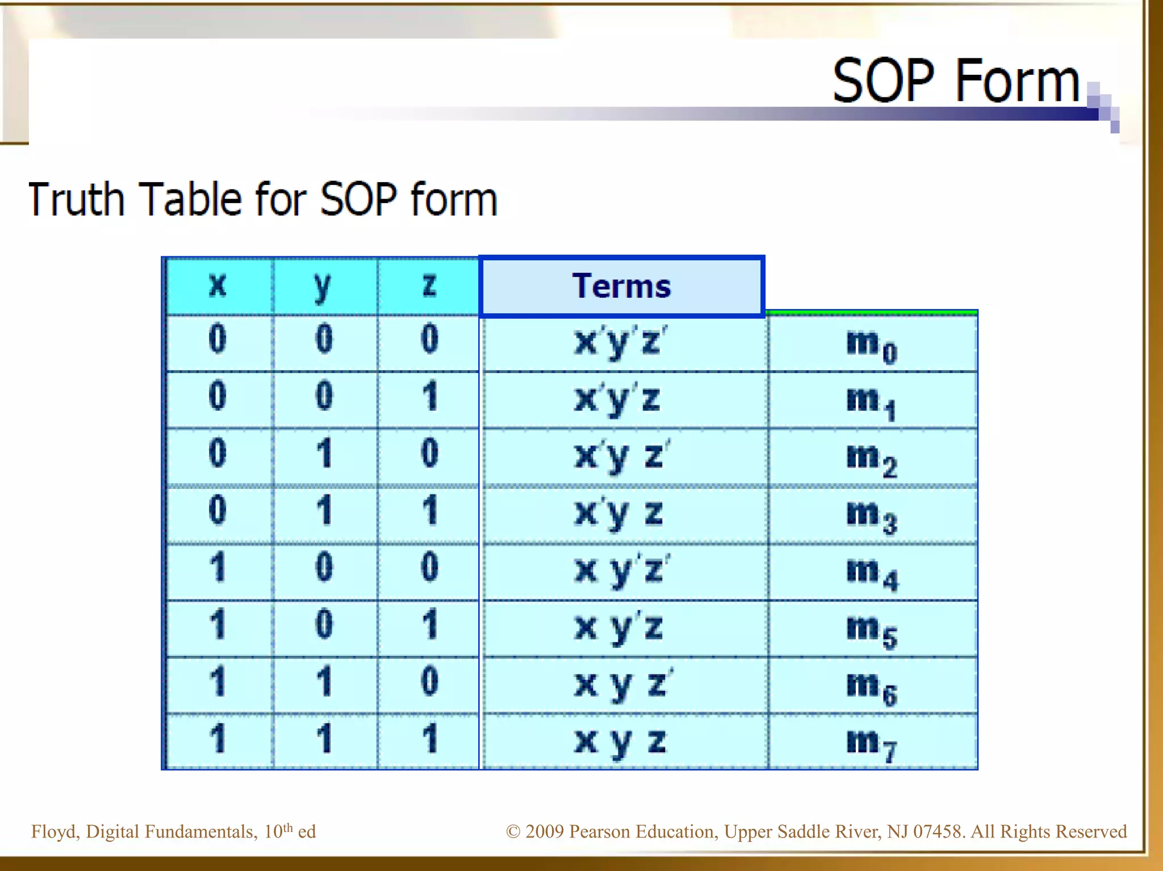

Slide 53
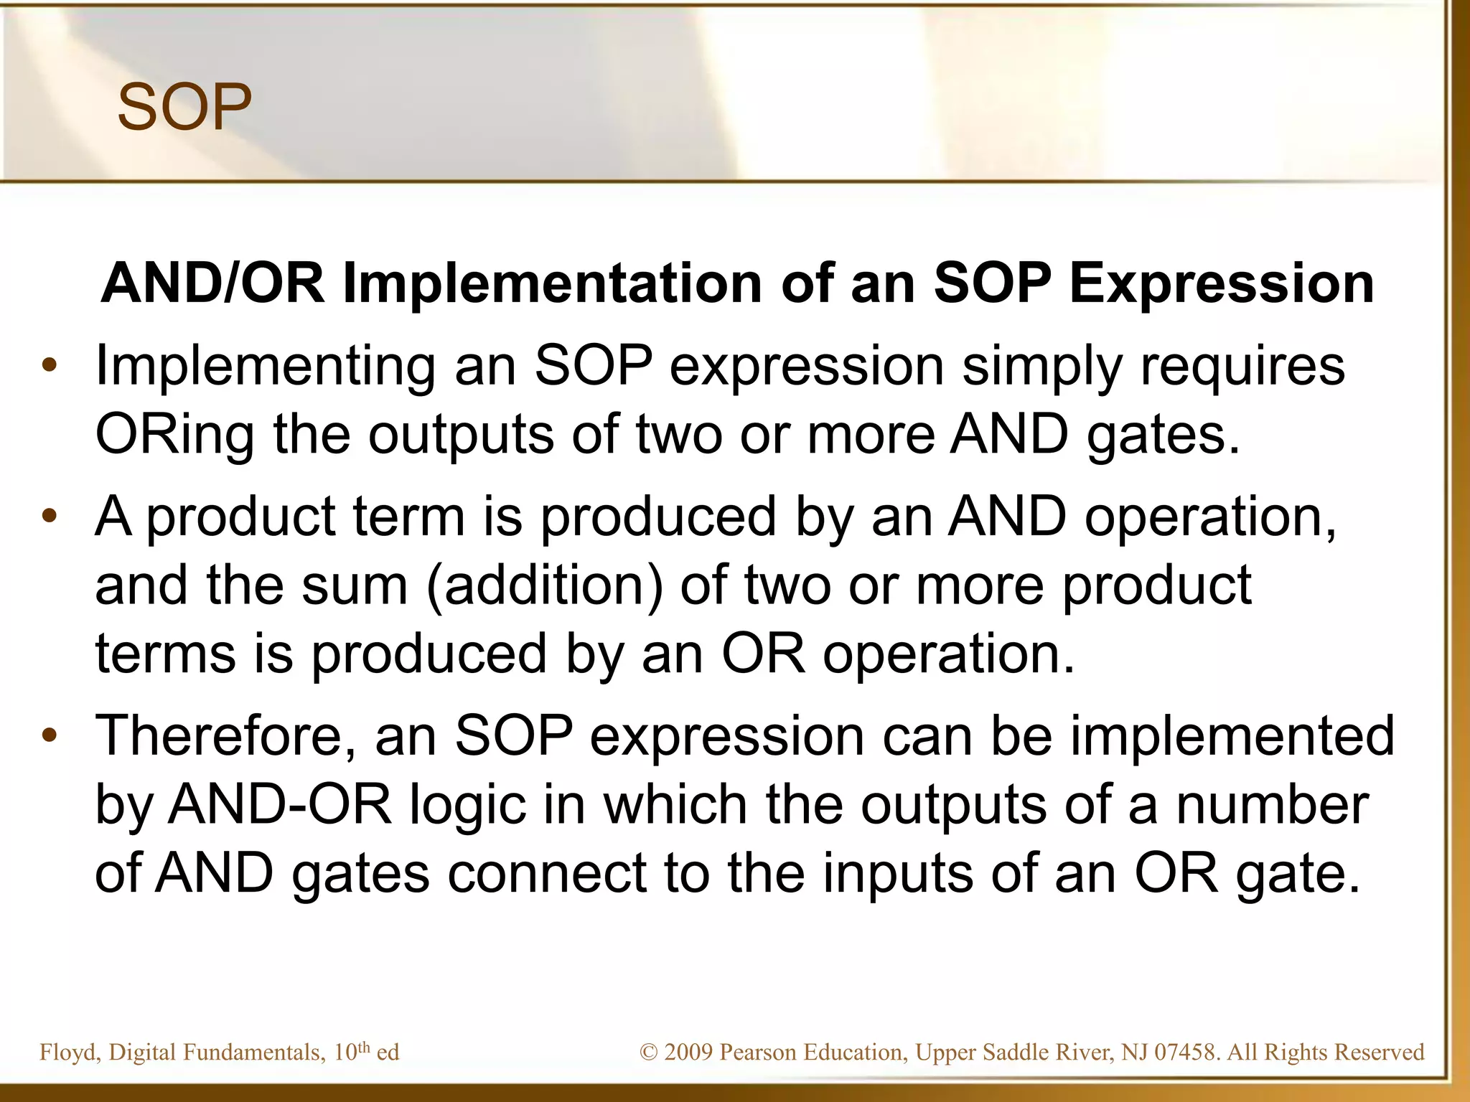

Slide 54
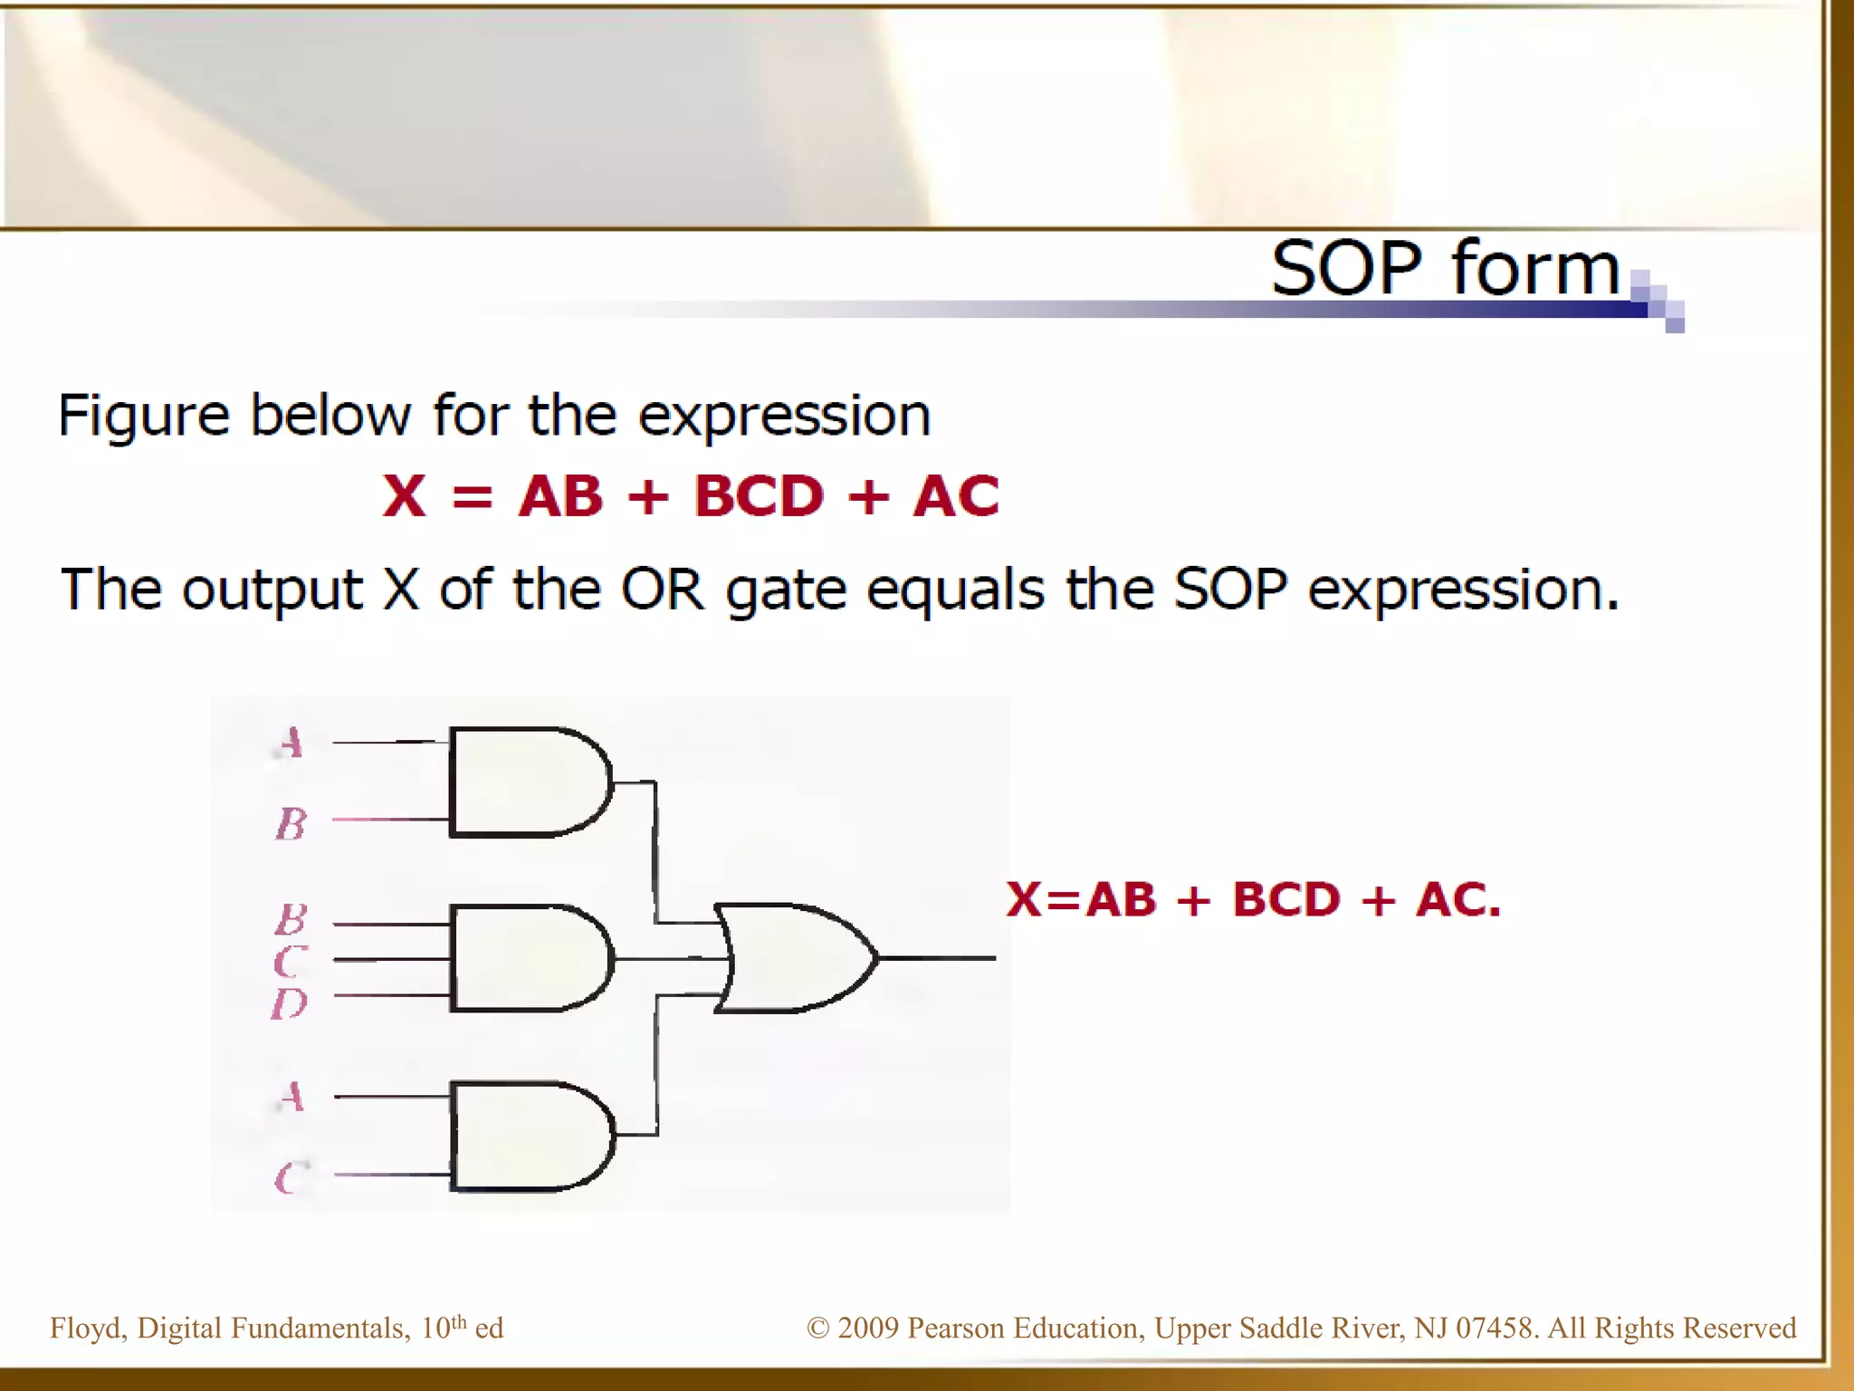

Slide 55
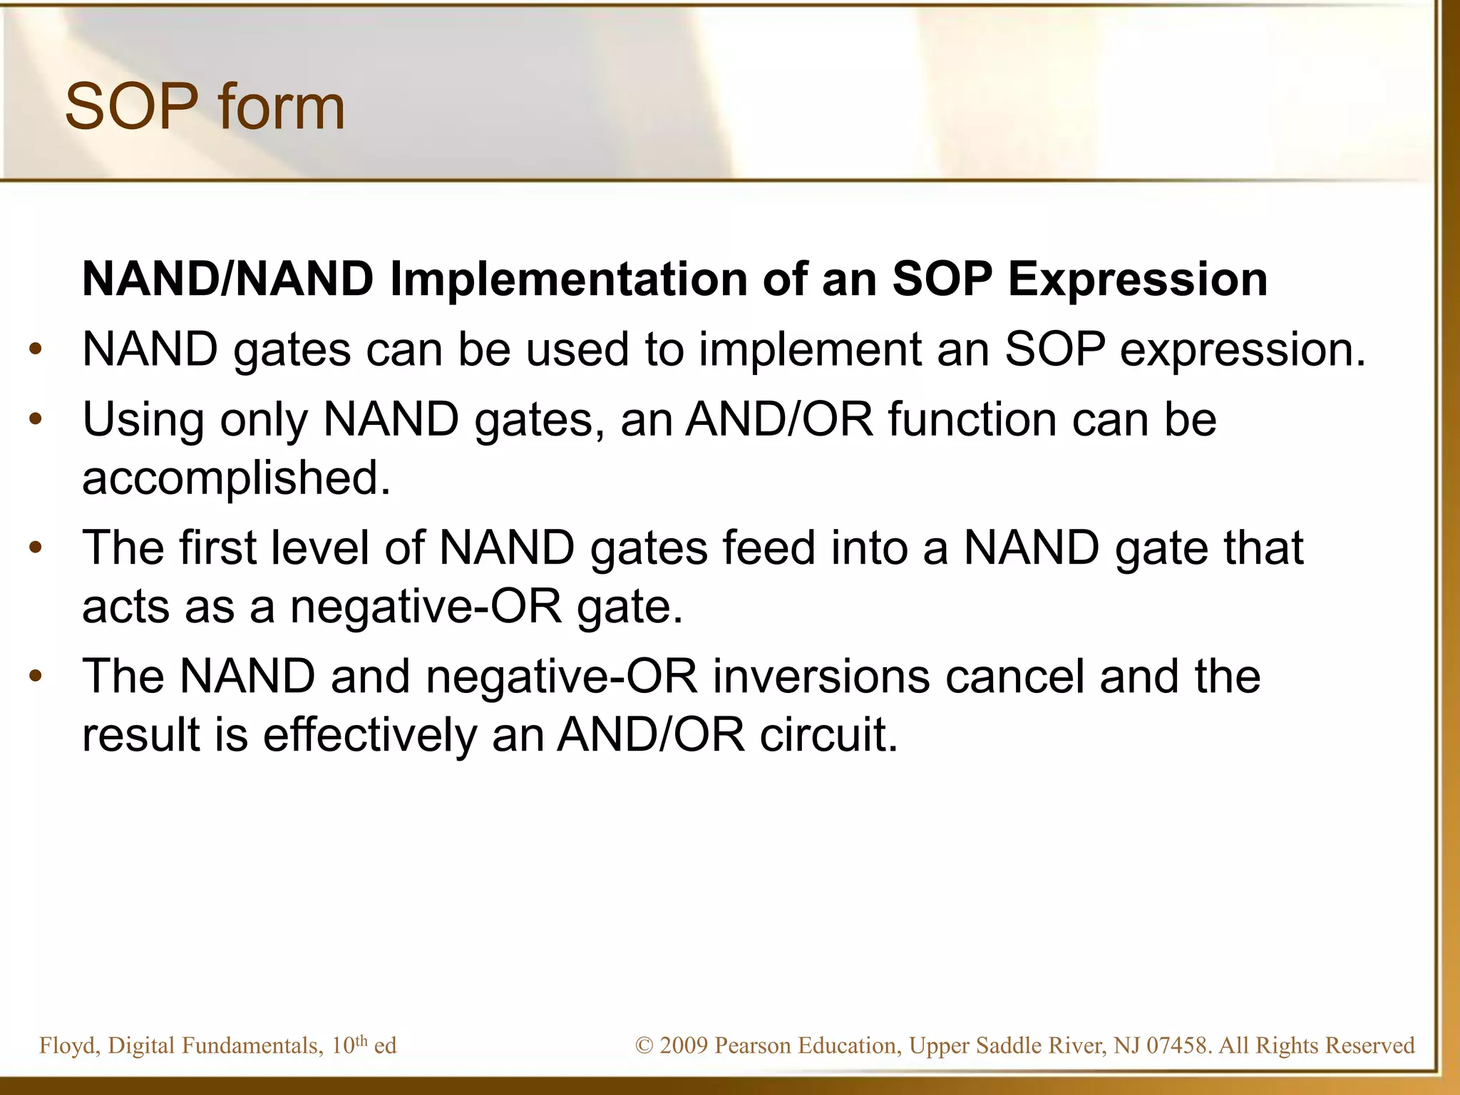

Slide 56
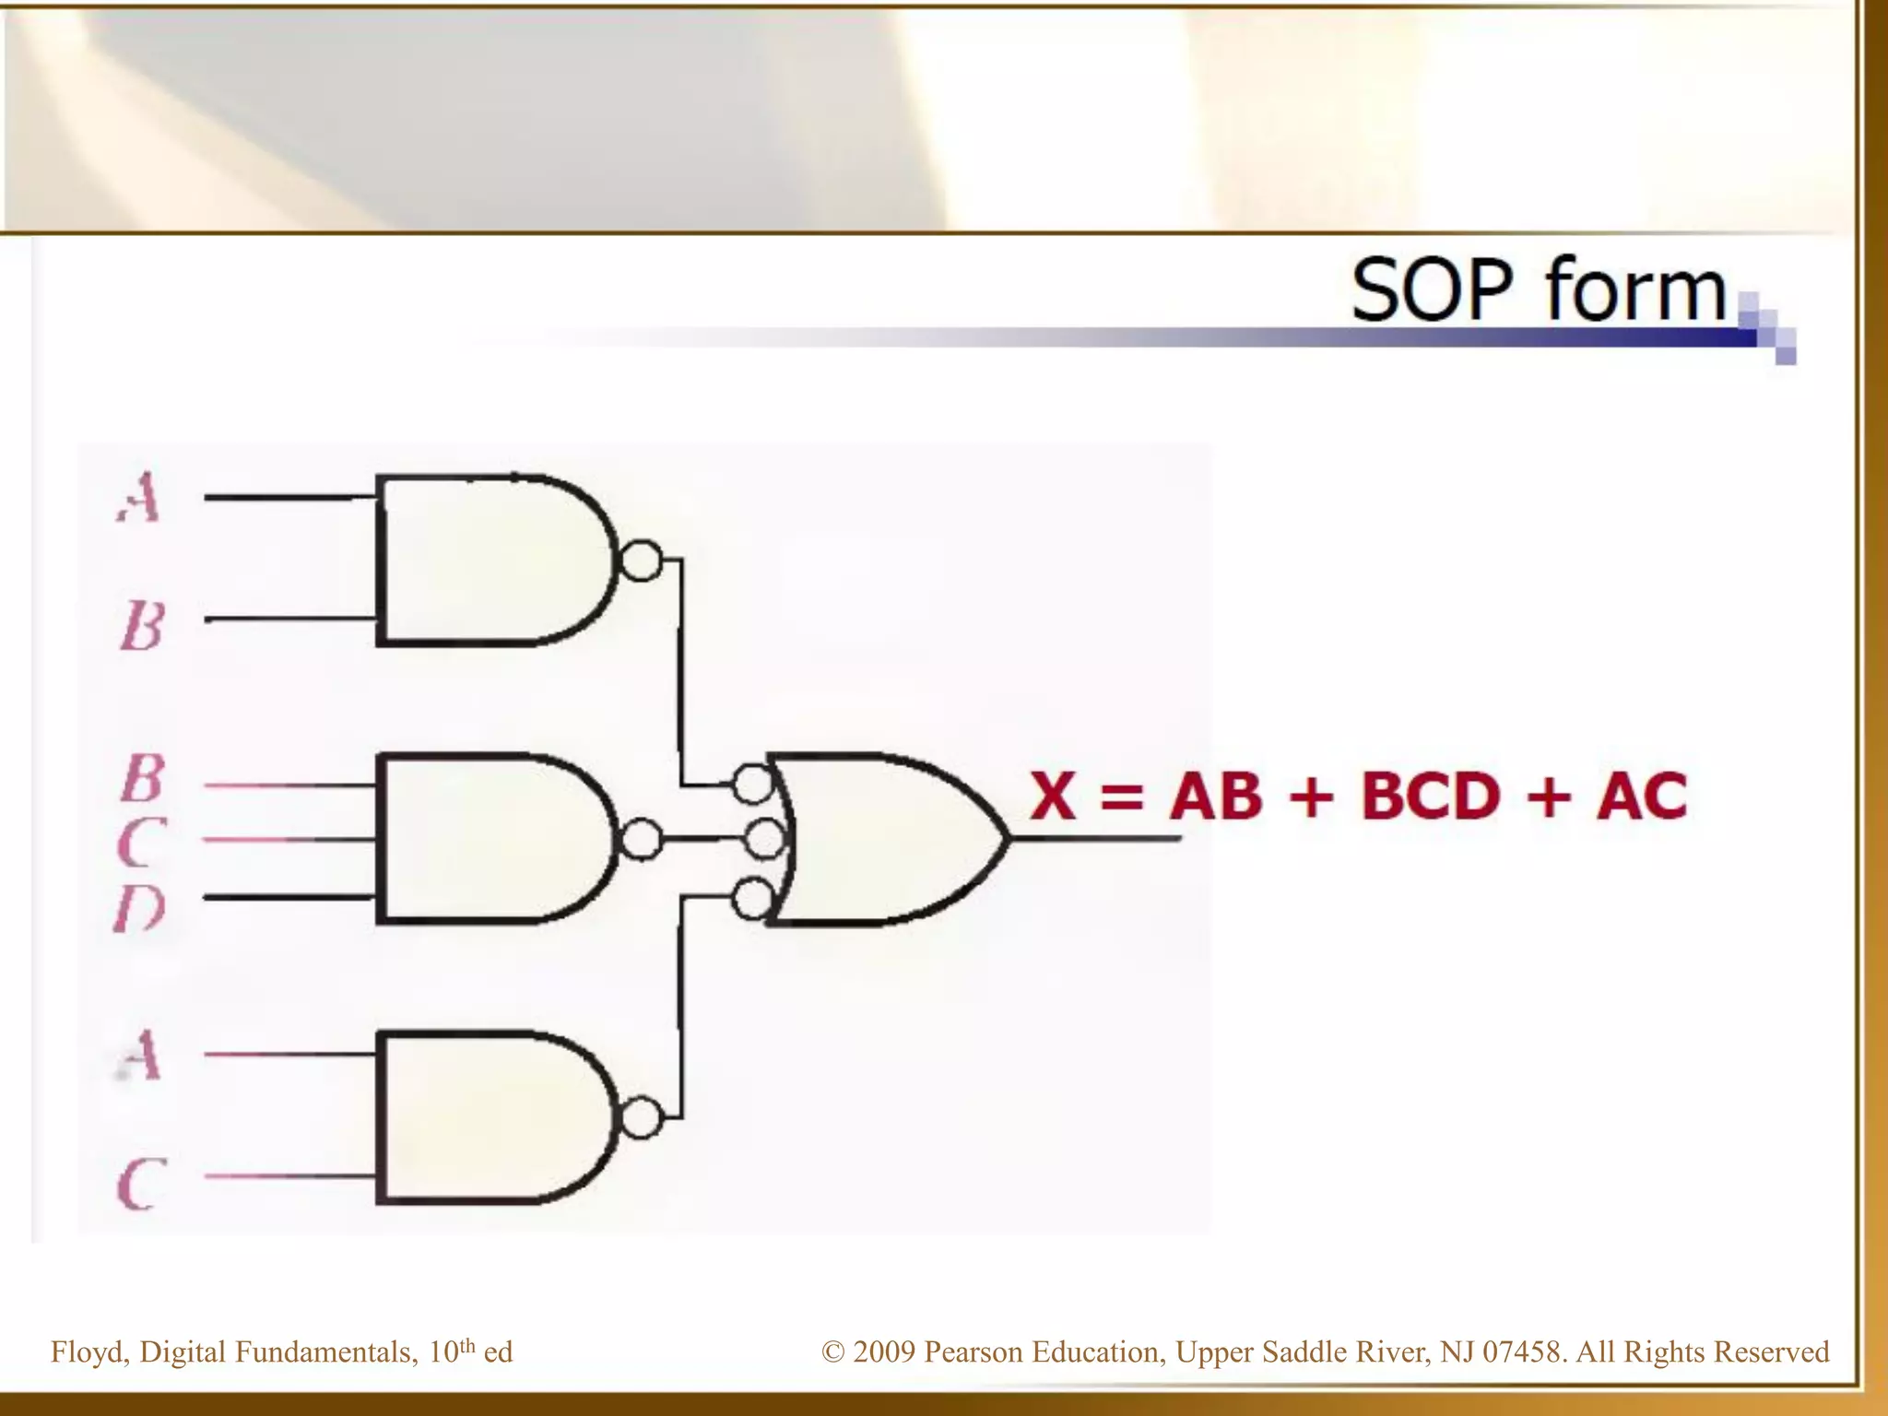

Slide 57
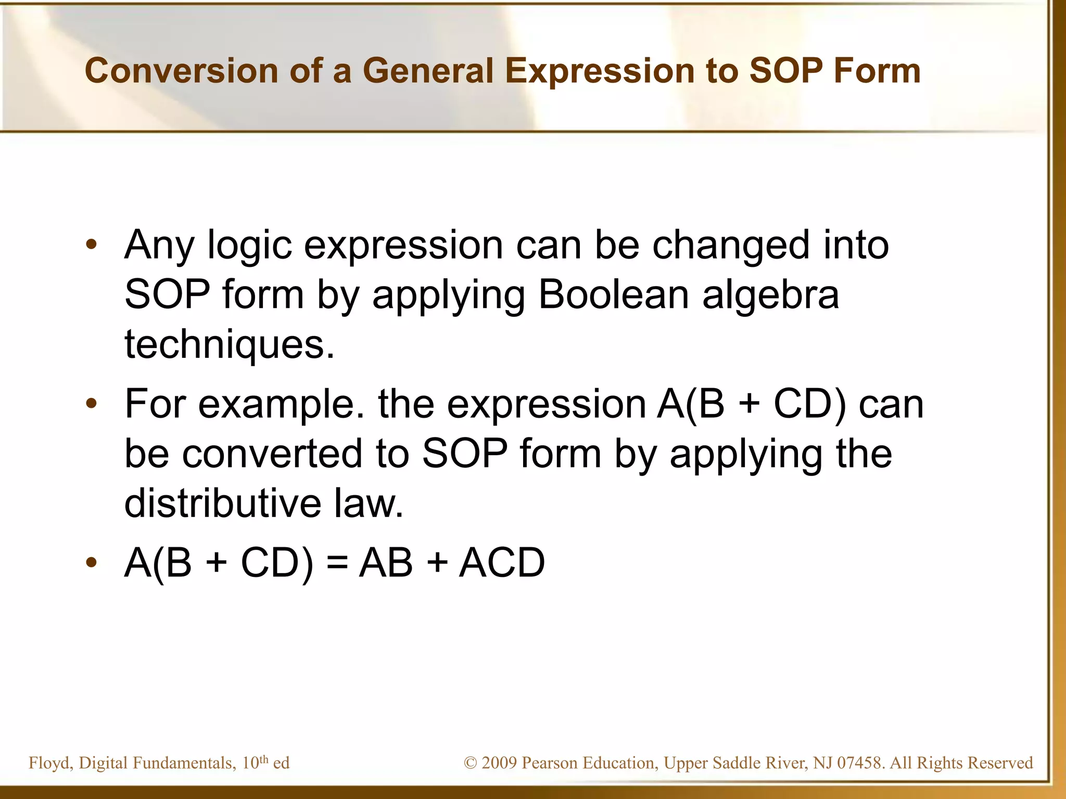

Slide 58
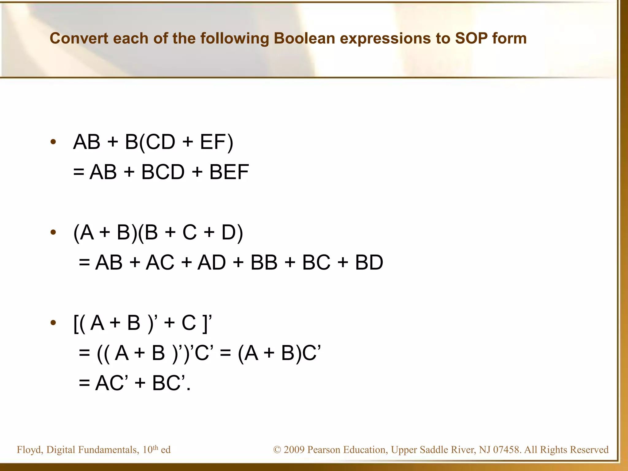

Slide 59
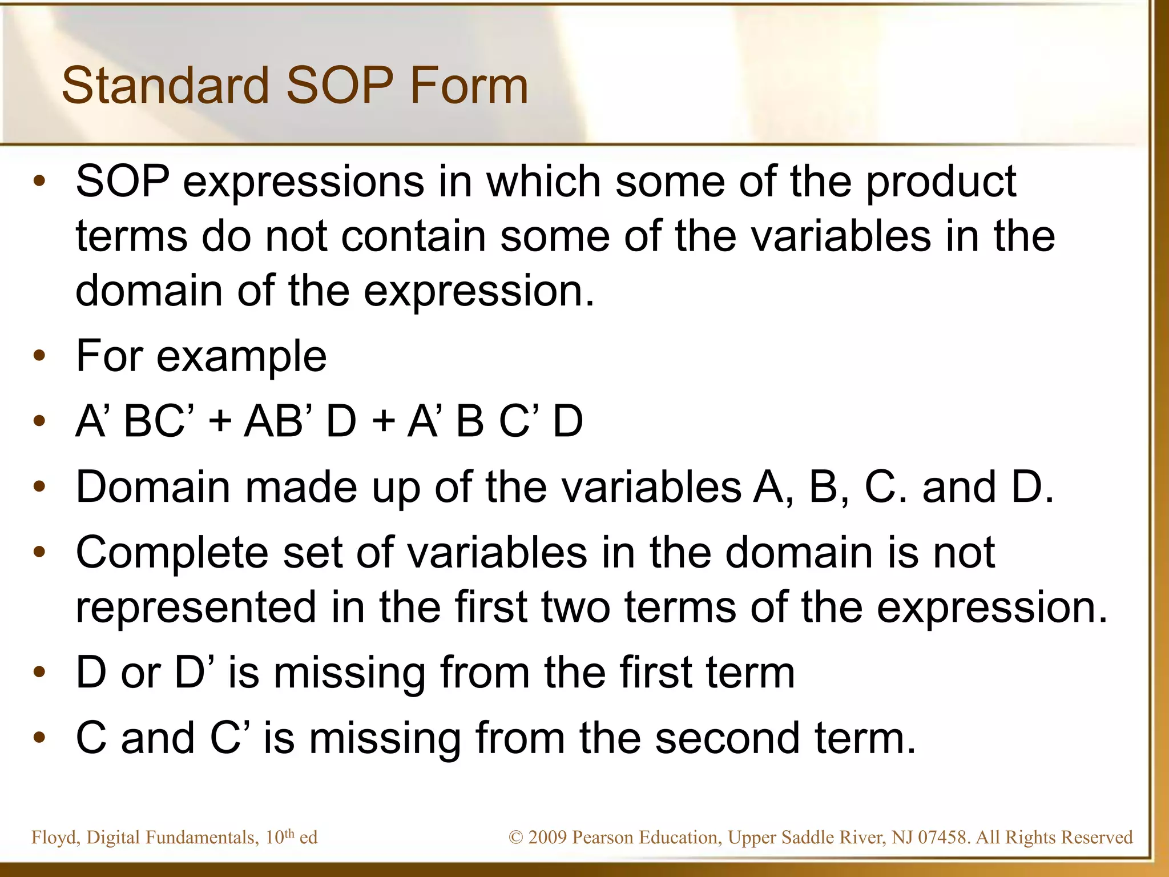

Slide 60
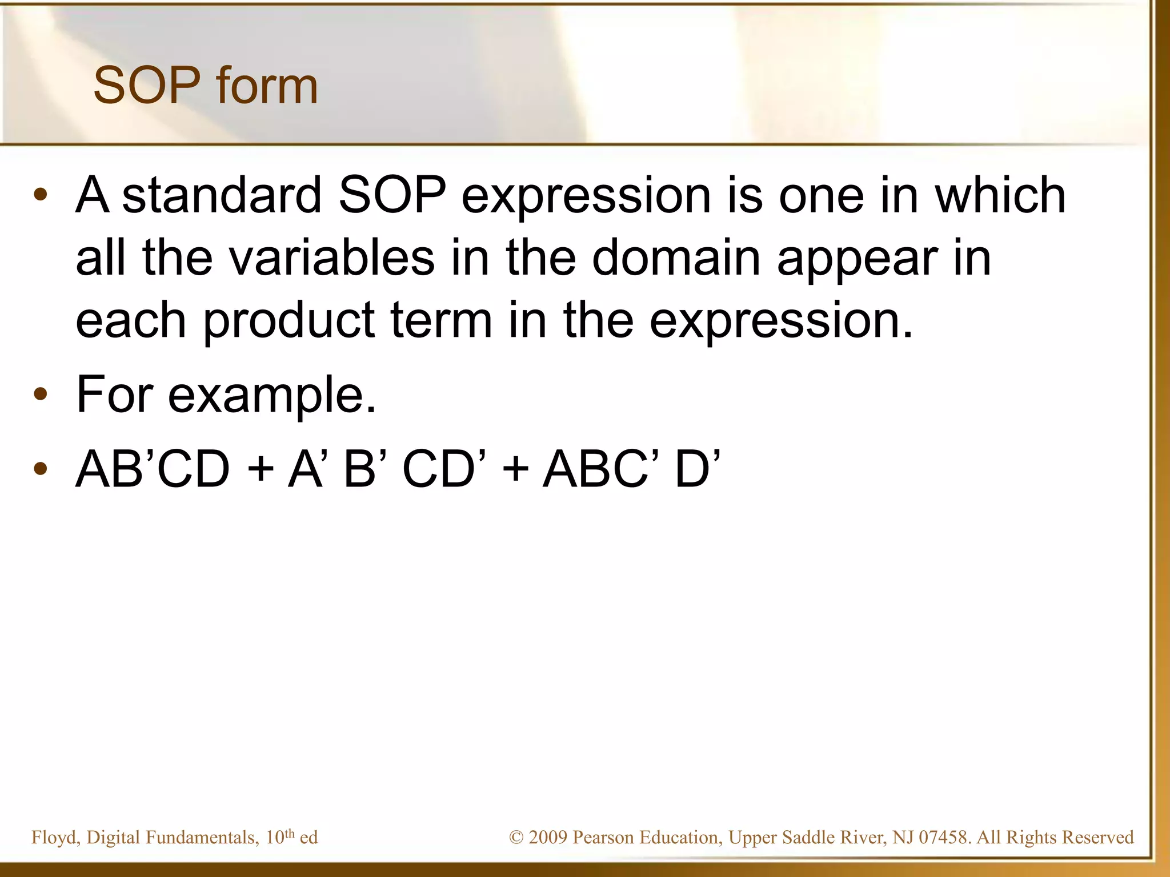

Slide 61
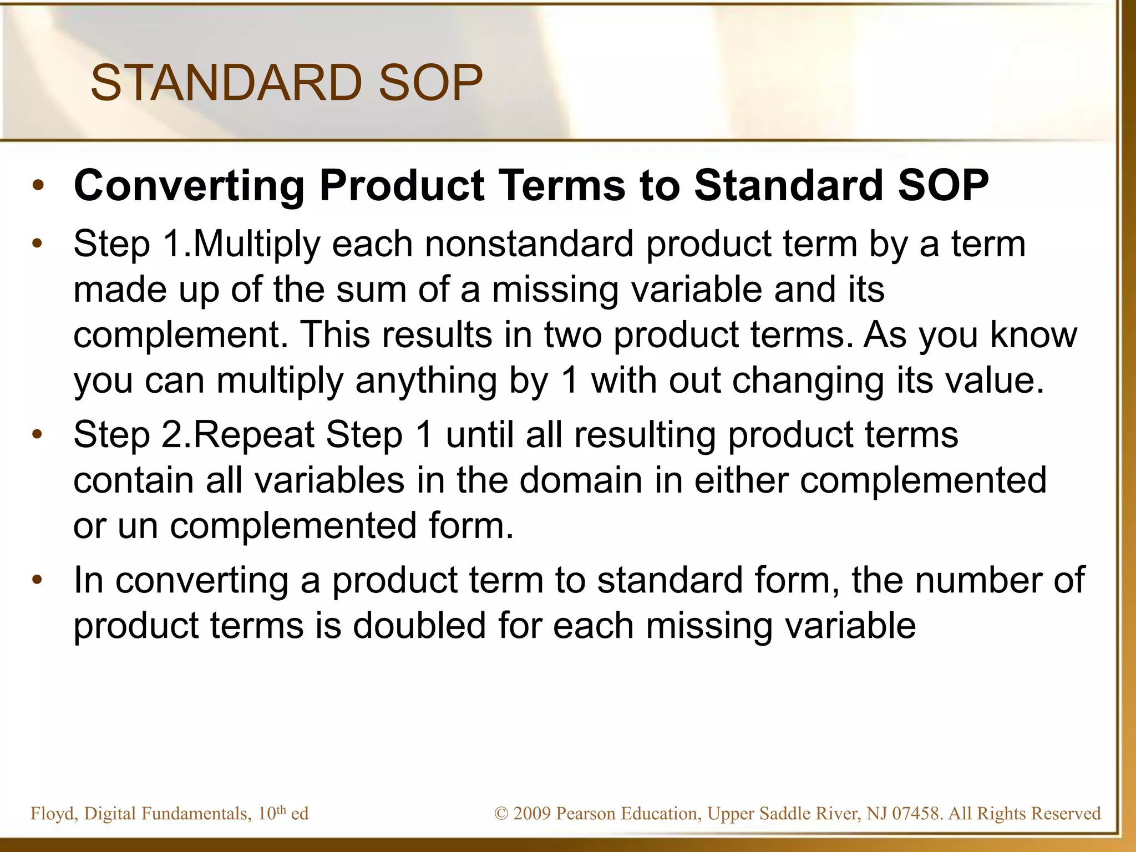

Slide 62
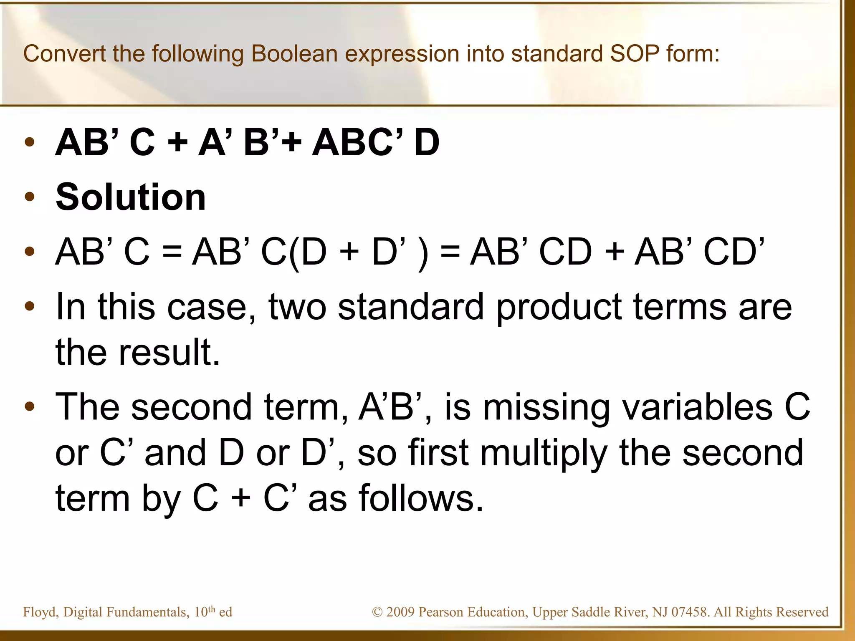

Slide 63
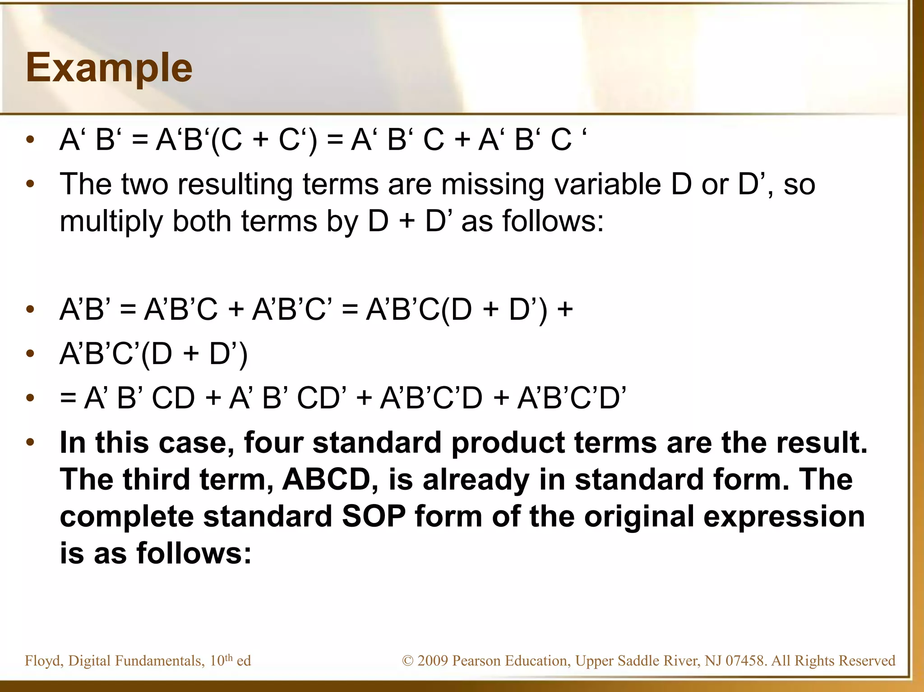

Slide 64
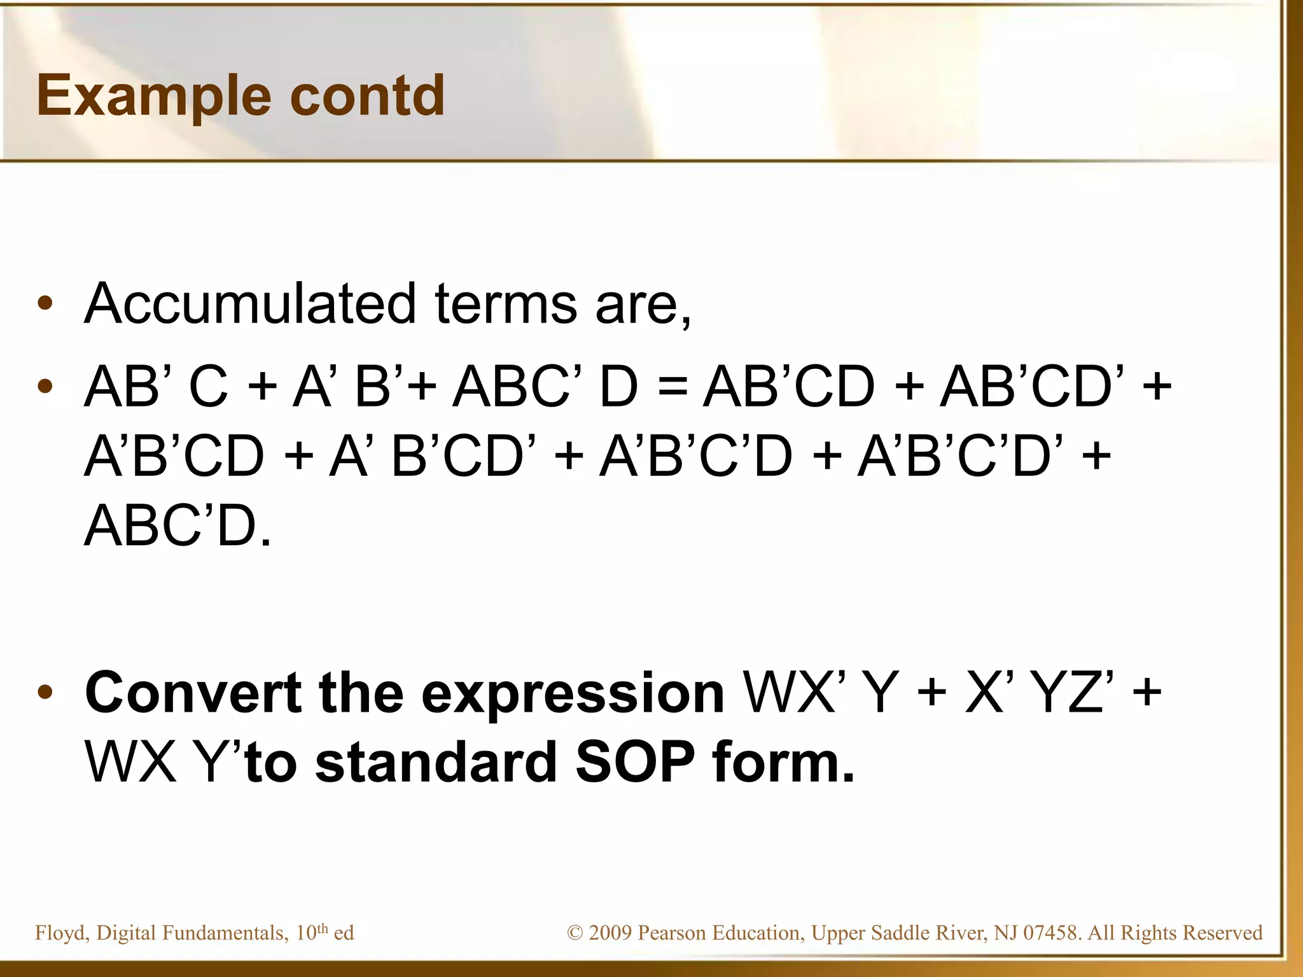

Slide 65
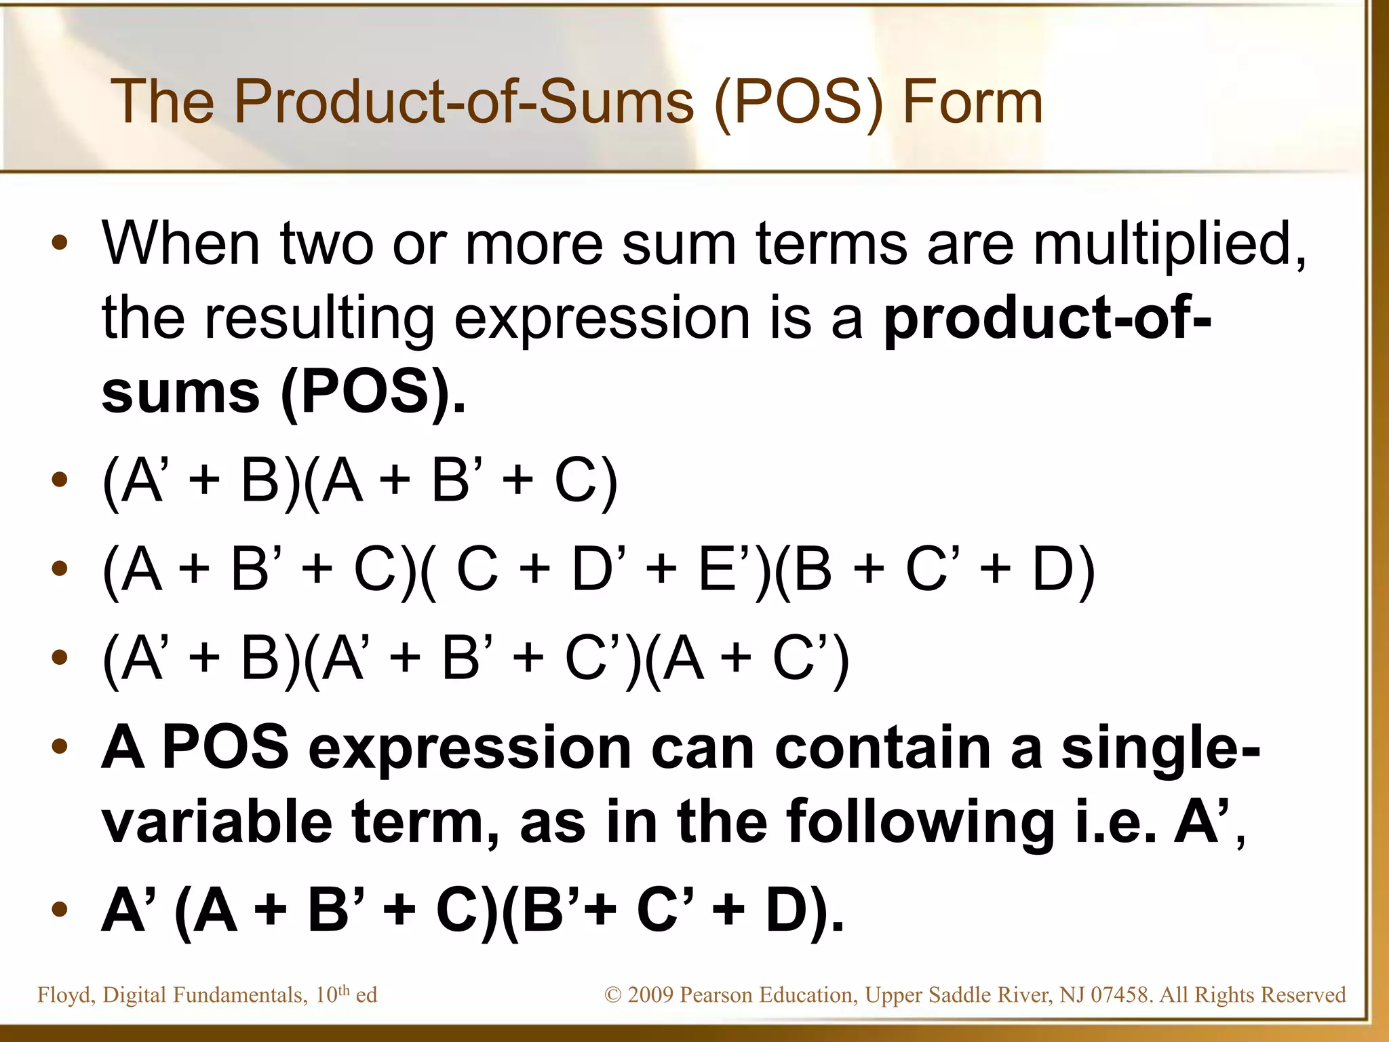

Slide 66
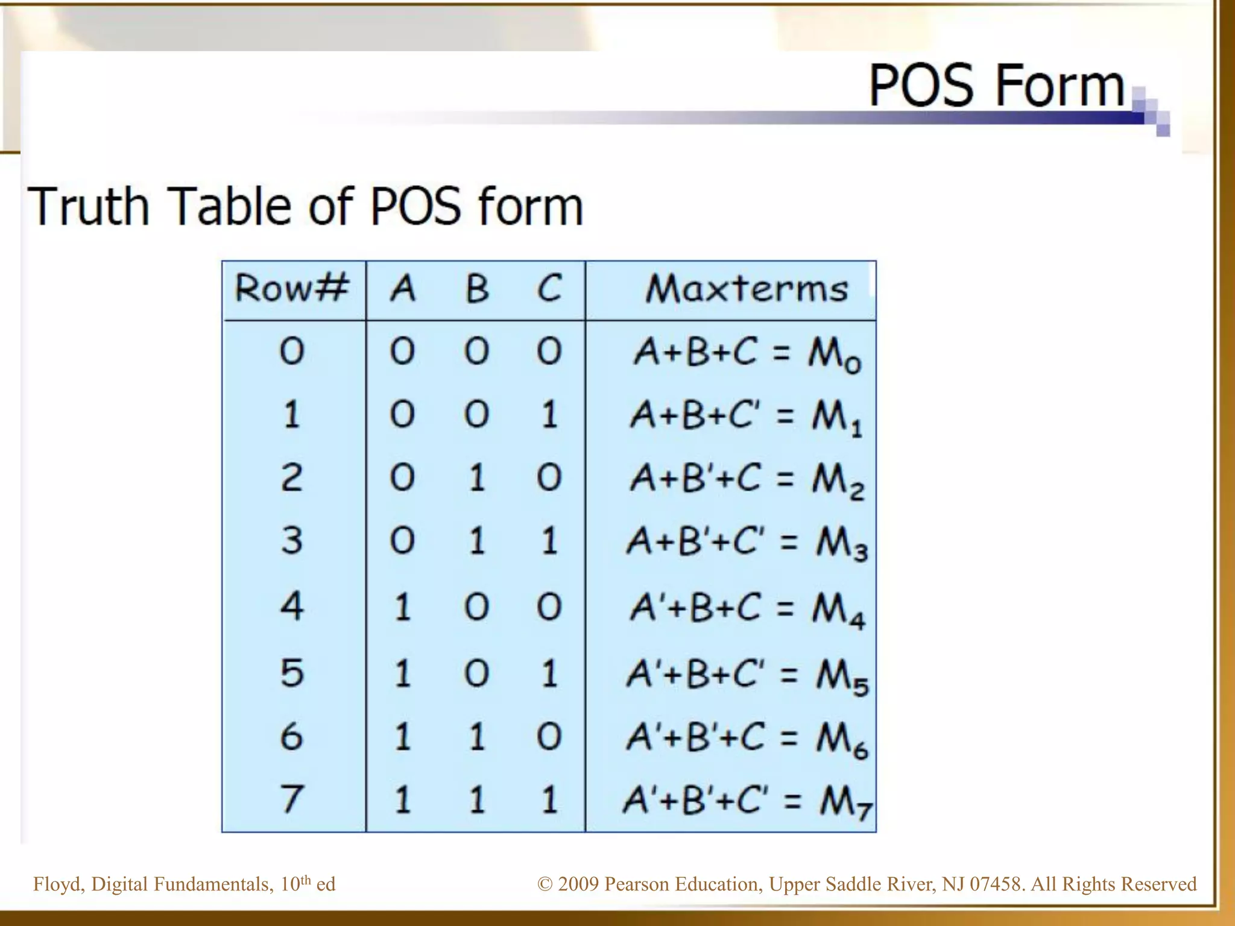

Slide 67
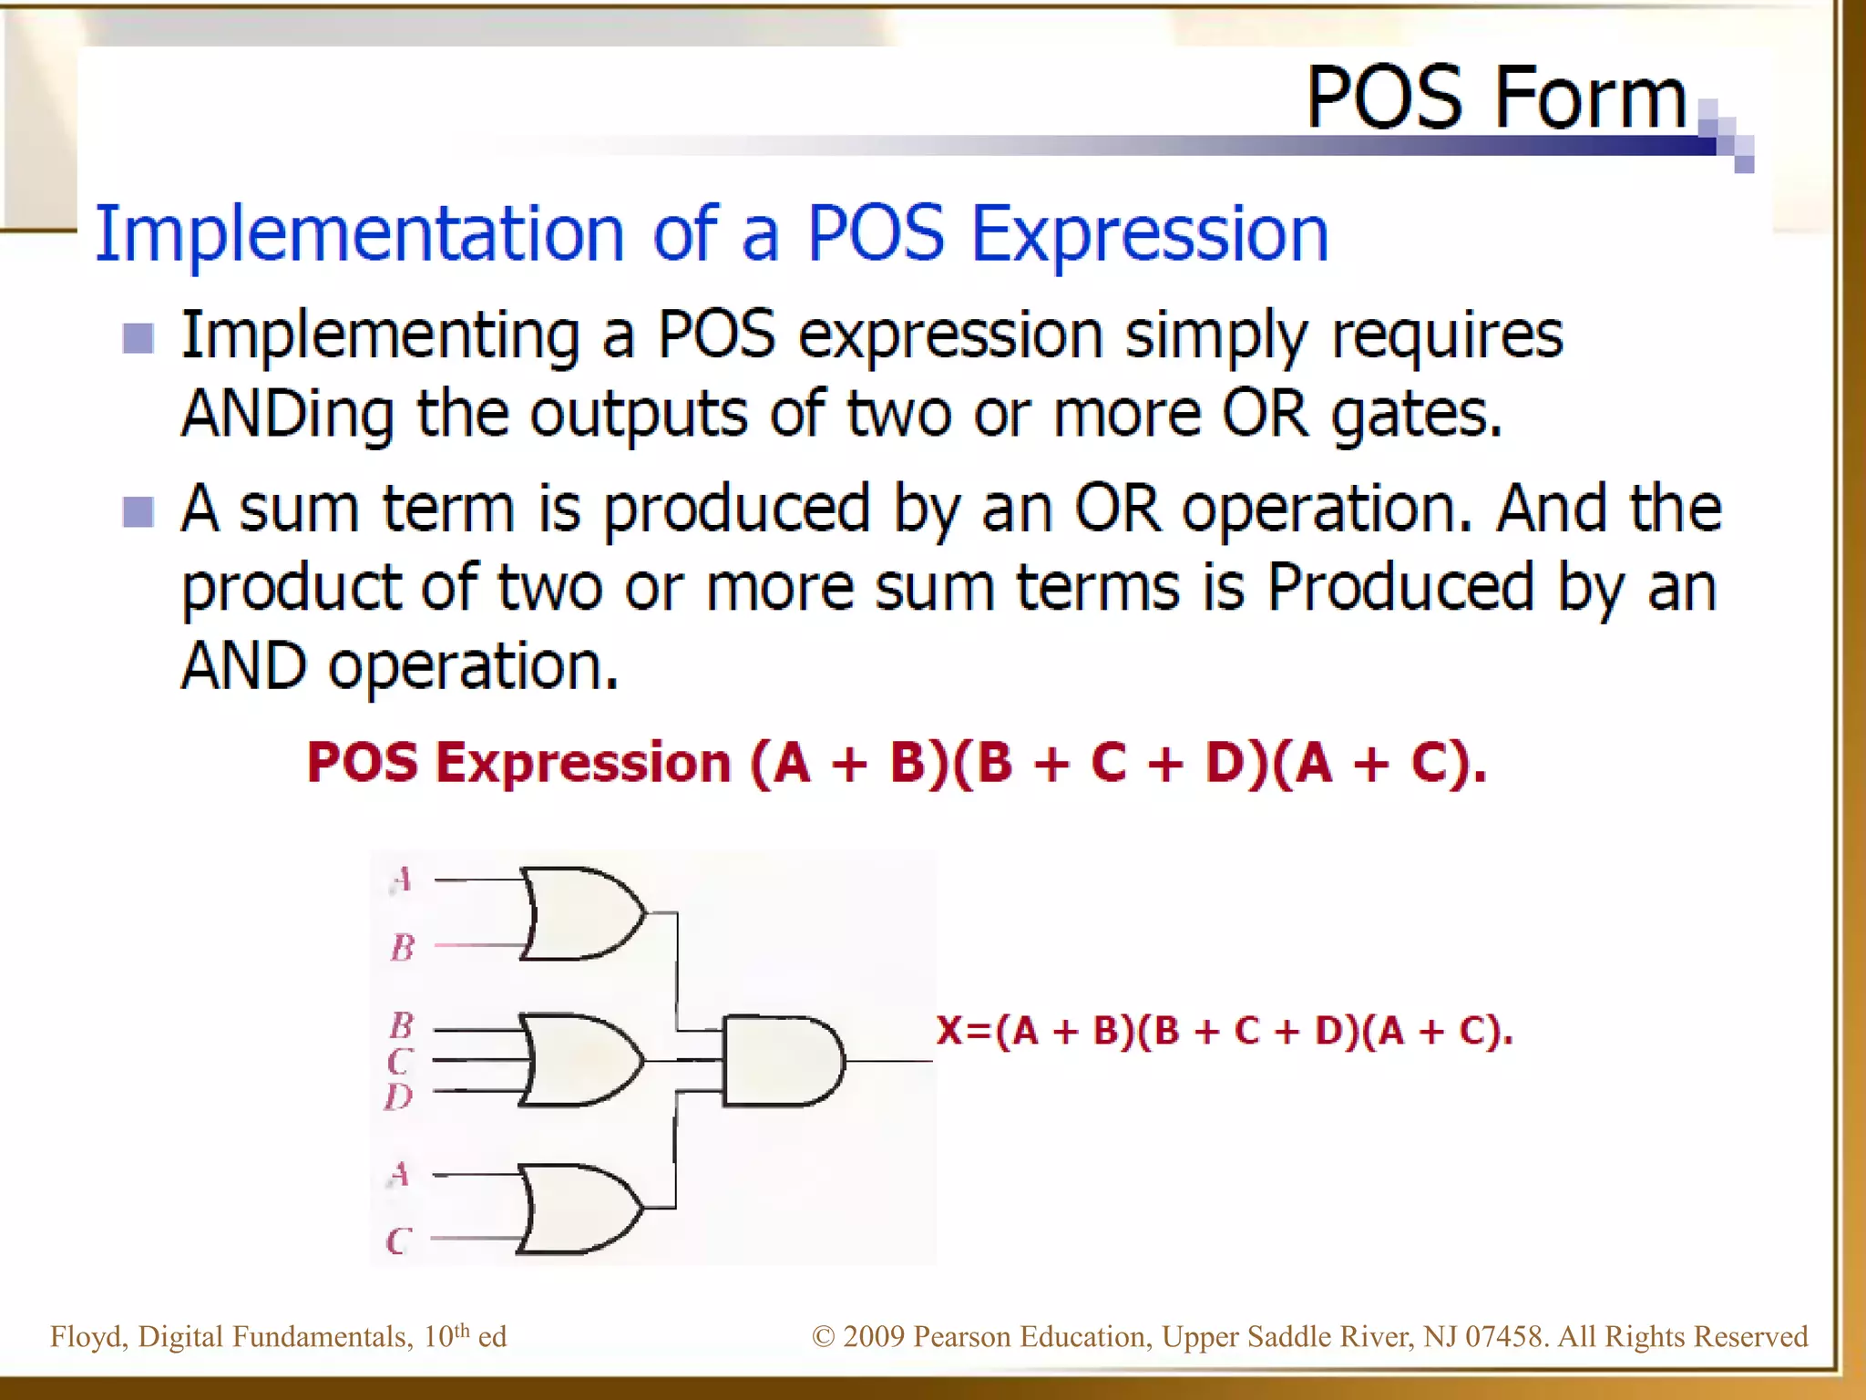

Slide 68


Slide 69


Slide 70


Slide 71


Slide 72


Slide 73


Slide 74


Slide 75


Slide 76


Slide 77


Slide 78


Slide 79


Slide 80


Slide 81


Slide 82


Slide 83


Slide 84


Slide 85
Karnaugh Map(K-Map) method
The K-map is a systematic way of simplifying Boolean expressions. With the help of the K-map method, we can find the simplest POS and SOP expression, which is known as the minimum expression. The K-map provides a cookbook for simplification.

Slide 86
steps used to solve the expressions using K-map:
First, we find the K-map as per the number of variables.
Find the maxterm and minterm in the given expression.
Fill cells of K-map for SOP with 1 respective to the minterms.
Fill cells of the block for POS with 0 respective to the maxterm.
Next, we create rectangular groups that contain total terms in the power of two like 2, 4, 8, … and try to cover as many elements as we can in one group.
With the help of these groups, we find the product terms and sum them up for the SOP form.

Slide 87
Rules for simplification
Karnaugh Maps - Rules of Simplification

